Slide 1
Melanoma: Increased surveillance and diagnosis. Is this a bug or a feature?
Robert A. Swerlick, MD.
Alicia Leizman Stonecipher Professor and Chairman Emeritus
Department of Dermatology
Emory University

Slide 3
Disclaimer
I have no financial conflicts associated with this discussion

Slide 4
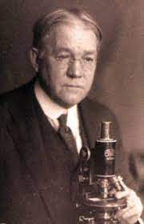
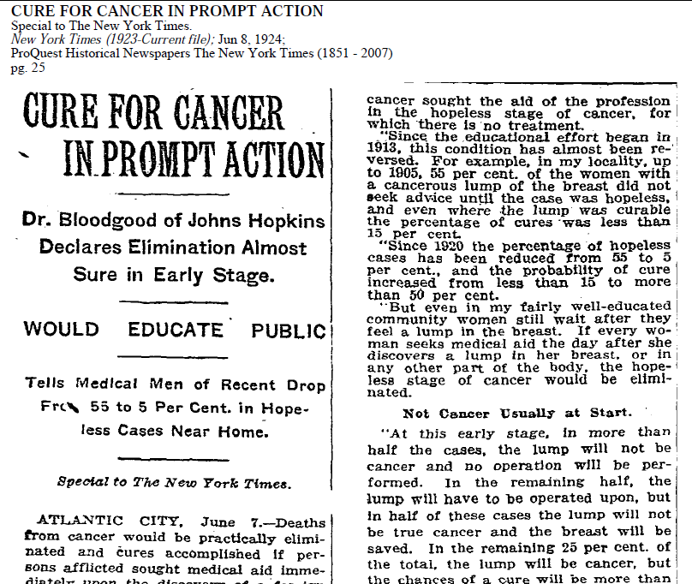
Origins of enthusiasm for cancer screening
and early cancer diagnosis
Dr. Joseph Colt Bloodgood
“Deaths from cancer would be practically eliminated.. If persons afflicted sought medical aid immediately upon the discovery of a foreign growth in any part of the body.”
What could go wrong with such an approach?
Notes:
Modern concepts of skin cancer screening can be traced back to Dr. Joseph Colt Bloodgood, a Hopkins based surgeon who practiced 100 years ago.

Slide 5
Pigmented lesion management goals of care
Small pigmented lesions ranging from banal nevi to early invasive melanoma are almost invariably asymptomatic and devoid of inherent “illness experience”.
The goals of surveillance, biopsy, and removal is to prevent the later development of advanced melanoma and melanoma death.

Slide 6
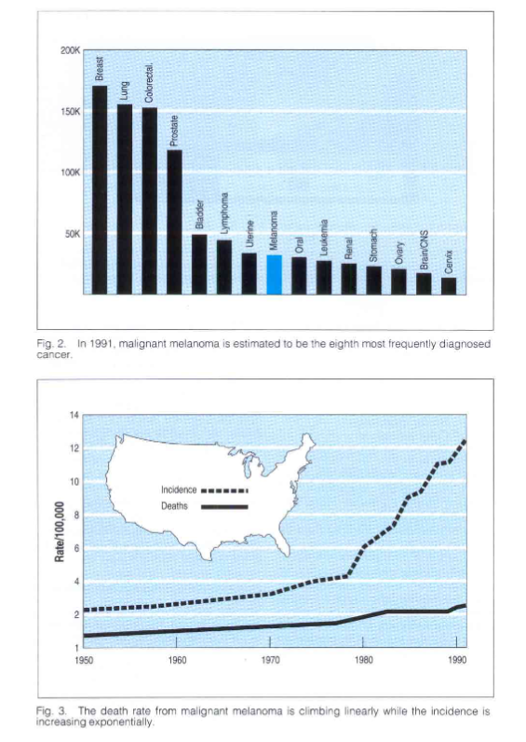
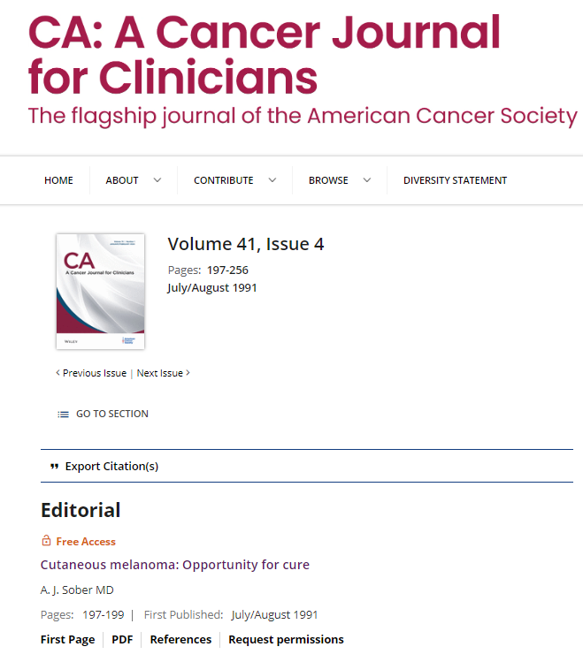
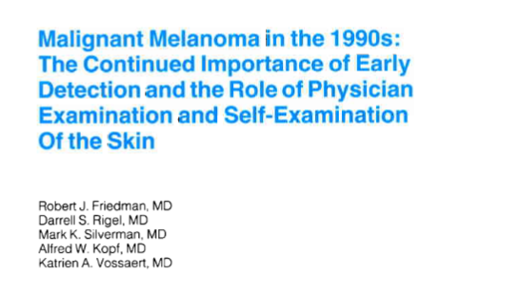
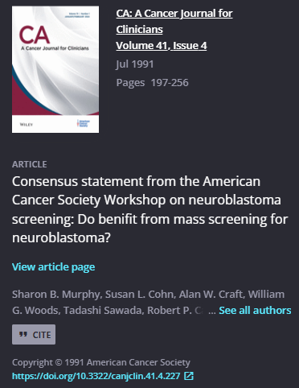

Slide 7
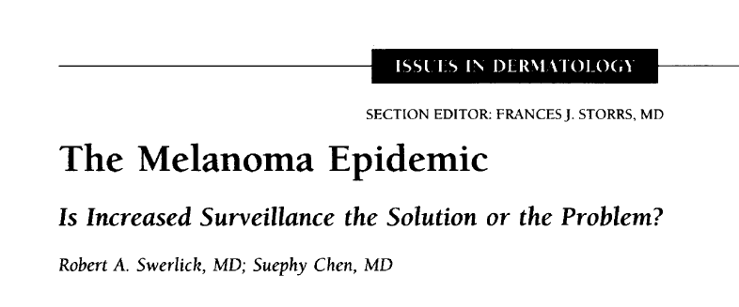

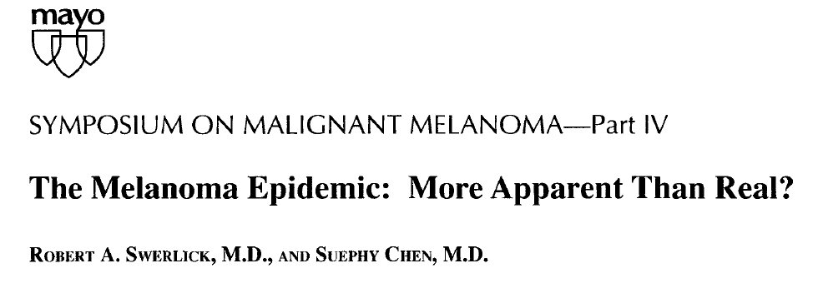

“Attempts to increase screening intensity for melanoma may result in further increases in diagnosis of melanomas.”
Swerlick and Chen 1997
Notes:
Suephy Chen and I raised concerns about a possible diagnostic artifact resulting in increasing frequency of melanoma diagnosis more than 20 years ago. Our concerns did not alter practice patterns in dermatology and remained peripheral to broad concepts driving melanoma diagnosis and management – until very recently.

Slide 8
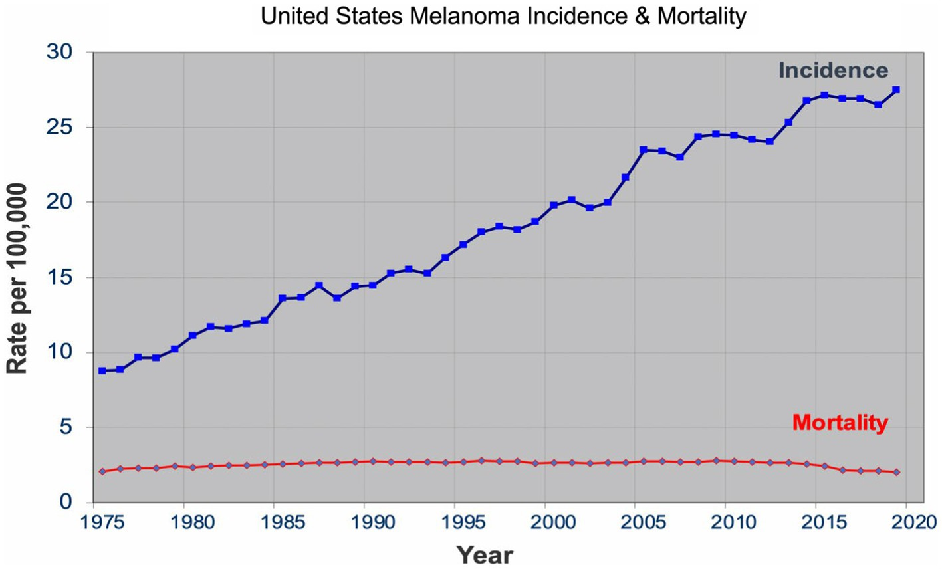
Front. Med., 21 November 2023

Slide 9
Pigmented lesion management goals of care
Increased melanoma detection in the absence of any effect on mortality or advanced tumors suggests that these well-intended efforts have failed to provide any value to the patients to whom efforts were directed and much of the increased diagnosis of melanoma is attributable to overdiagnosis.

Slide 10
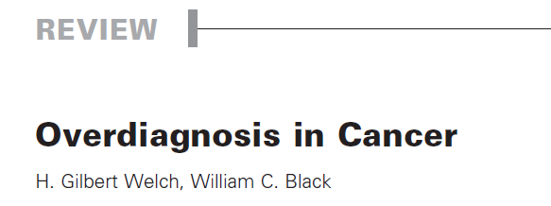
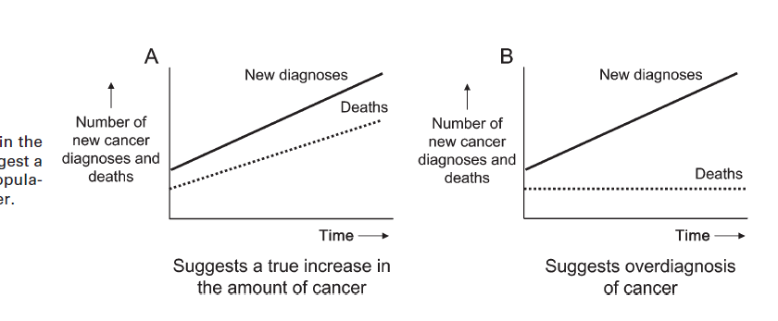
J Natl Cancer Inst 2010;102:605–613

Slide 11
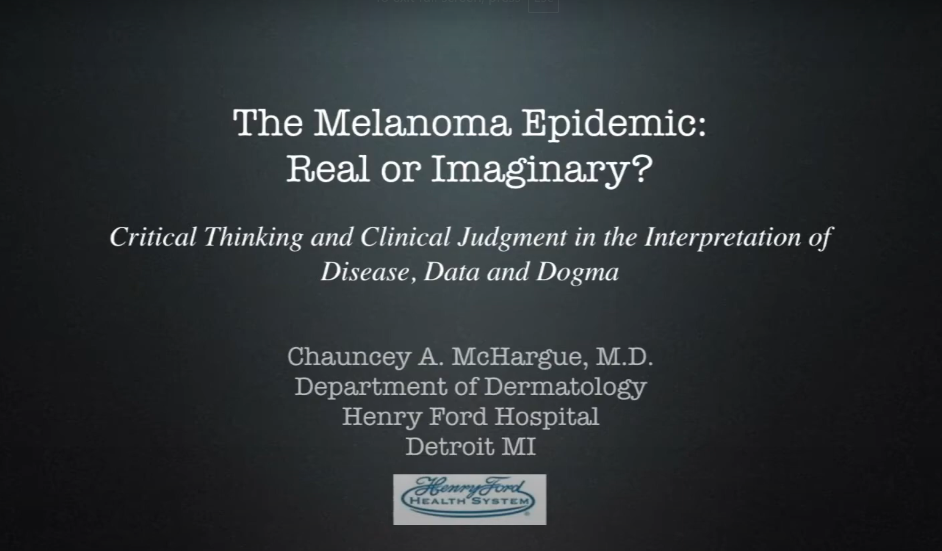
https://www.youtube.com/watch?v=Y8teF9SWspA&t=1480s

Slide 12
Increased Surveillance is Associated with an Increased Dx of Melanoma
Increase surveillance efforts in Australia, Switzerland, Scotland, Sweden, Germany, France, and the United States resulted in increased biopsy rates and melanoma diagnosis.
The excess cases are explained by increased detection of thin melanomas and no survival benefit was demonstrated.

Slide 13
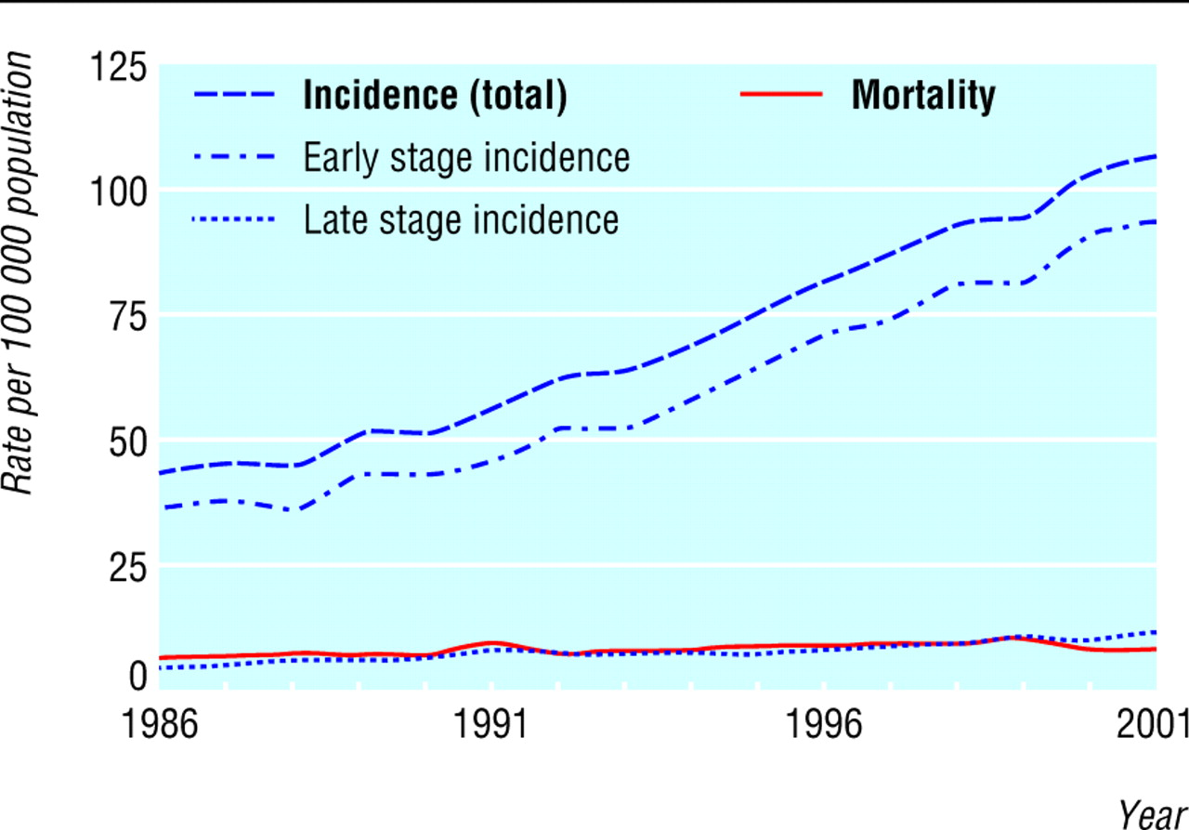

Fig 1. Incidence of melanoma and mortality in population aged 65 and older residing in one of nine US areas participating in Surveillance Epidemiology and End Results programme, 1986-2001. Early stage refers to in situ and local disease; late stage refers to regional and distant disease
Welch, H G. et al. BMJ 2005;331:481
Copyright ©2005 BMJ Publishing Group Ltd.

Slide 14
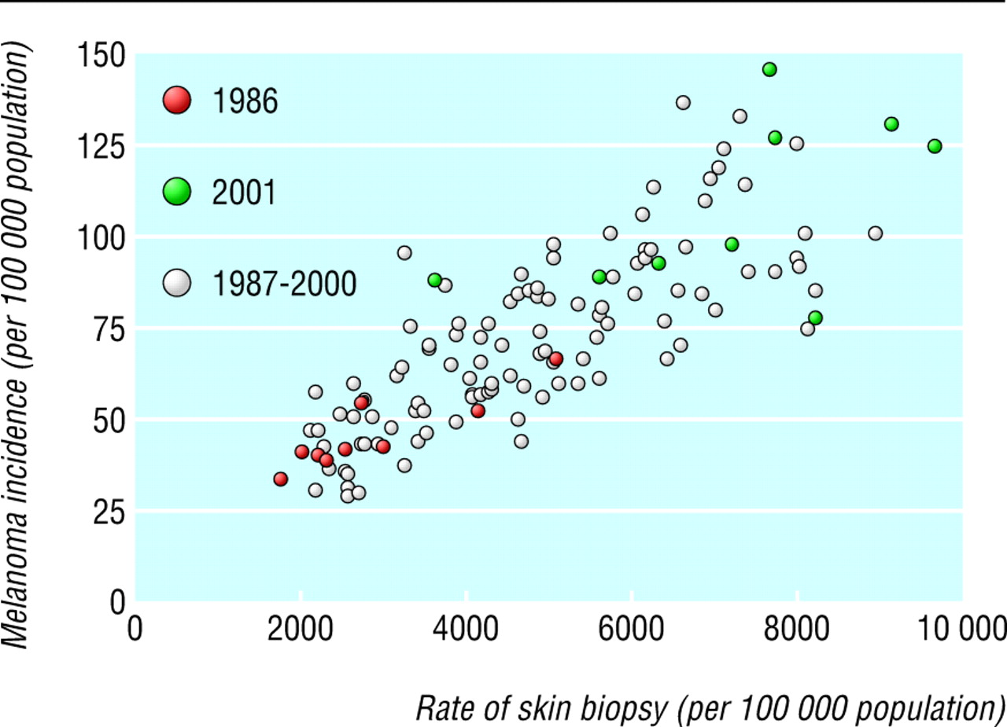
Fig 2 Scatterplot of annual rate of skin biopsy and incidence of melanoma for residents age 65 and older in each of nine US areas participating in Surveillance Epidemiology and End Results programme, 1986-2001
Welch, H G. et al. BMJ 2005;331:481
Copyright ©2005 BMJ Publishing Group Ltd.

Slide 15
Increased skin biopsy rates in Medicare population
1986-2001 – increased by 10%/yr
  Baseline bx rate in 1986 = 1550 bx/100K people
2002-2009 – increased by 6%/yr
  7,012 bx/100,000 persons in 2002 to 10,528 biopsies per 100,000 persons in 2009.
2009-2019 - 5% growth/yr
  FFS Medicare population 2019 = 45 million
  7.9 million skin biopsies in 2019 = 17500 bx/100K

Slide 16
What do these observations imply?
These findings suggest the existence of a significant reservoir of indolent pigmented lesions which can and will be discovered when surveillance intensity is increased through skin checks and skin biopsies

Slide 17
What do these observations imply?
These results point to the detection of pigmented lesions that clinically and histologically have elements in common with malignant melanoma but do not exhibit the malignant behavior of what has been associated with melanoma

Slide 18
Thin melanoma prediction
Thin, invasive (<0.8 mm) melanomas and in situ disease, if left untreated, will invariably evolve into aggressive melanoma.
  If we did not remove this melanoma, you would have died
  "Extraordinary claims require extraordinary evidence“ - Carl Sagan

Slide 19
The Pathology Problem
We use pathologic diagnosis as the gold standard for melanoma diagnosis
The case inputs into melanoma pathology diagnosis have changed over the past century
The task now asked of pathologists may not be appropriate for the tools at their disposal
Predicting the future always has inherent uncertainty and diagnostic terms and concepts must recognize the uncertainty
Notes:
Test – tissue fixed in formladehyde, embedded in paraffin, thinly sliced and placed on glass slides where it was stained with textile dye.

Slide 20
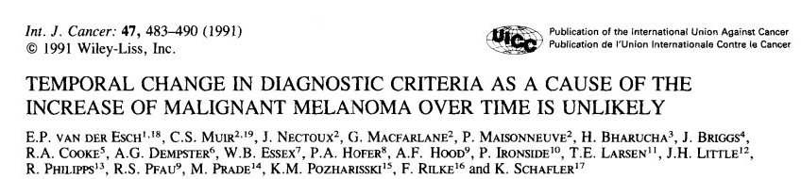
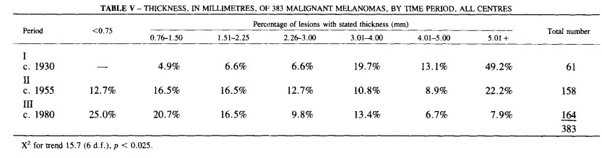
>85%
<40%
NO MIS Included

Slide 21
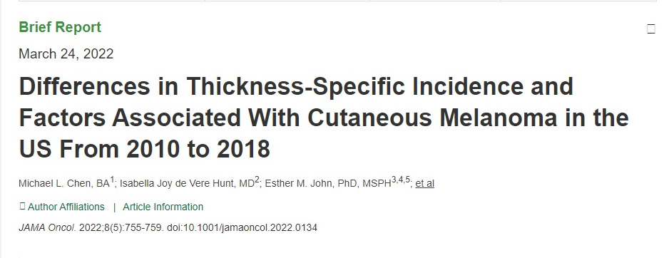
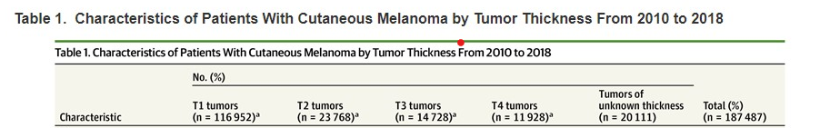
70% ( 0%) 16%% (85%)
MIS not included

Slide 22
Melanoma Diagnosis as a Prediction
1930’s Melanoma scenario
  Clinical presentation - pigmented nodule
  DDx - Hemangioma, melanoma, SCCA, cyst
  Pathologist functioned as a taxonomist

Slide 23
Melanoma as a Prediction
2020’s scenario
  Clinical presentation – 2-4 mm (diameter), thin pigmented macule
  DDX - nevus v. dysplastic nevus v. MIS v. melanoma v. lentigo
In the 2020’s, the pathologist functions not as a taxonomist but instead as an assessor of risk/actuary
Notes:
Is anatomic pathology actuarially sounds

Slide 24
Can we realistically expect pathologists to consistently and reproducibly identify the bad actors early in the course of disease given the tools they have at their disposal?
Notes:
Is anatomic pathology actuarially sounds

Slide 25
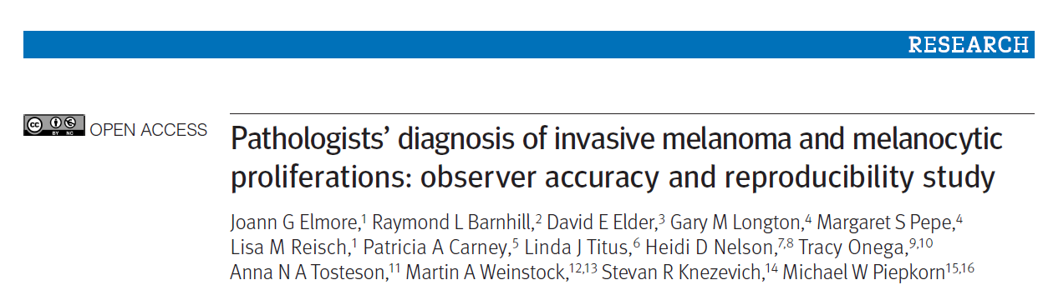

1187 pathologist – 8796 independent case reviews
Used MPATH-Dx reporting schema (I-V) with classes ranging from very low risk (I) to very high risk (V).

Slide 26
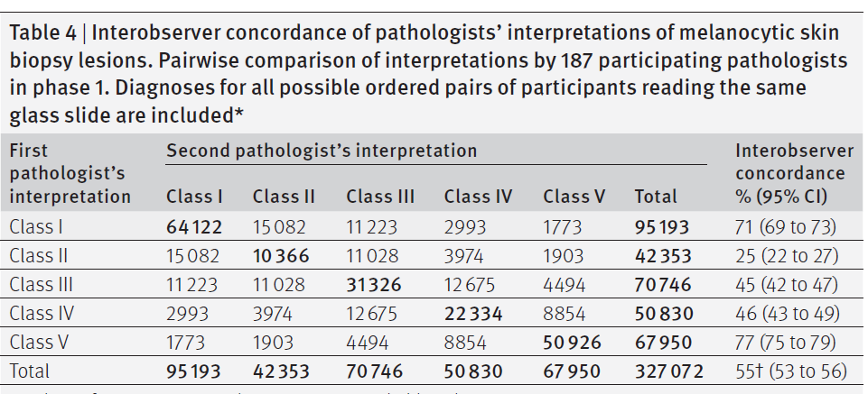

Slide 27
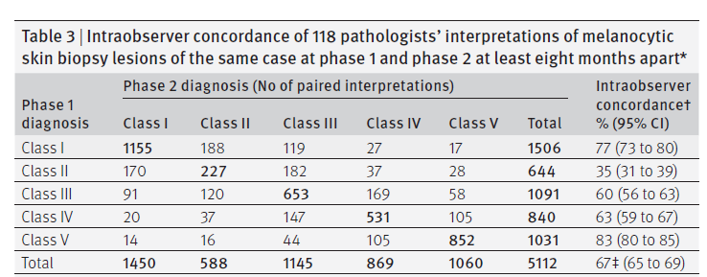
Pathological exam of pigmented lesions, which is the gold standard for diagnosis (prediction), does not provide consistent results of the most problematic lesions

Slide 28


Assessing risk- danger – sometimes easy
Pope John Paul
Who is/was dangerous?

Slide 29

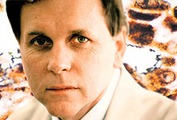
Assessing risk- danger – often not so easy
Barry Marshal 1995 Nobel Prize
for Medicine
Theodore Bundy – Notorious
Serial murderer

Slide 30


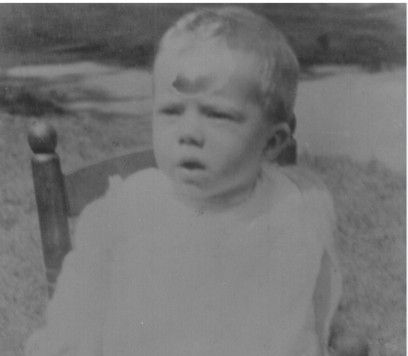

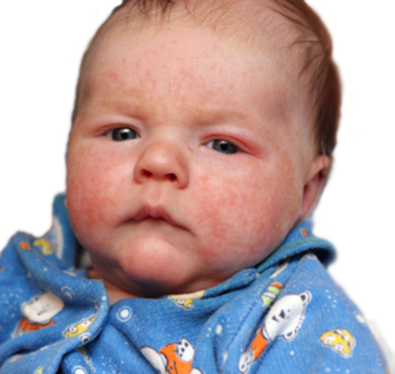
Assessing risk- danger – sometimes impossible
Who will be dangerous?
Martin Luther King
Adolf Hilter
Ted Bundy
Jimmy Carter
Charles Manson

Slide 31
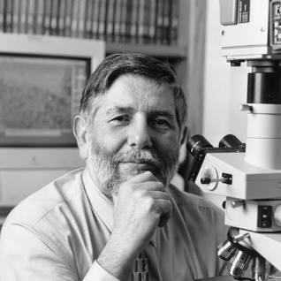
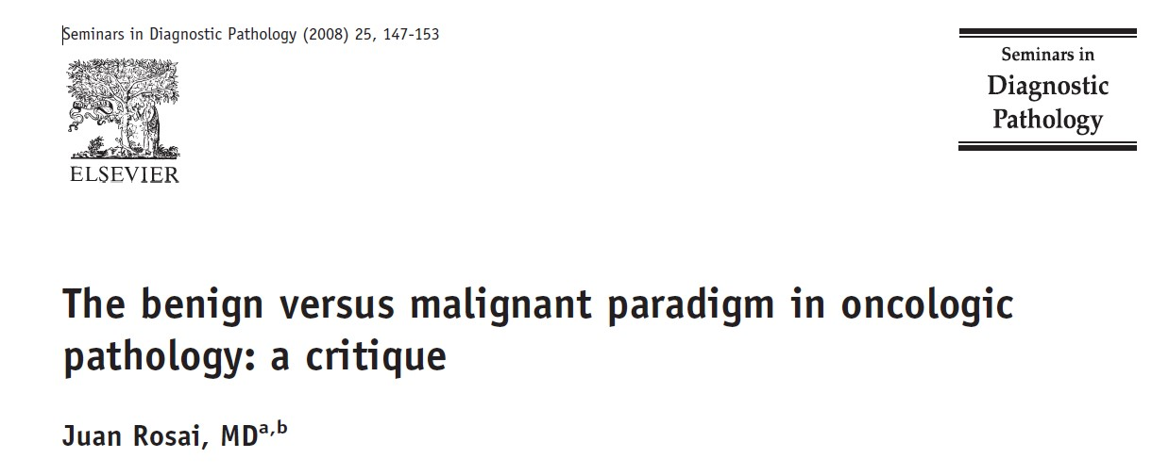
Juan Rosai (August 20, 1940 – July 7, 2020)

Slide 32
History of the Malignant/Benign dualistic paradigm
Rudolf Virchow – father of cellular pathology in his lectures at Charite’ Hospital divided tumors into benign and malignant
Subsequently, the ability of anatomic pathologists to make this distinction arguably has been the most important skill they possessed.
The case inputs have changed dramatically, involving a large spectrum of ambiguous tumors, exposing limitations of this paradigm.

Slide 33
Problems with the Cancer/Not Cancer paradigm
It represents an oversimplification that is a terrible model to base many clinical management decisions.
It may operate reasonably well at the polar ends of the disease spectrum but not in the middle where it is required most.
Application of the benign/malignant paradigm is not a difficult task. It is an impossible task when applied to ambiguous pigmented lesions.

Slide 34

Confusing Disease with Risk of Disease

Slide 35
Risk Factors v. Diseases
Risk Factor
Diseases
History of childhood AD
Asymptomatic hypertension
Osteoporosis
CKD stage II
Hyperlipidemia
Hyperglycemia
Melanoma in situ
Erythroderma with severe itch
Symptomatic CHF
Hip fracture
Renal failure on dialysis
Acute MI
Diabetic neuropathy
Metastatic melanoma with brain metastases
And the list can go on and on and on………..

Slide 36
Confusing Disease with Risk of Disease
High numbers of Americans are diagnosed with “early” stages of cancer which are more aptly viewed as risk states; yet they are treated as full-blown cancer with therapies that might be costly, risky, with benefits assumed rather than proven.
This is what has happened with a spectrum of pigmented lesions

Slide 37
Actionable items
When we deploy new diagnostic tools and therapeutic interventions for melanoma, we should test their impact on meaningful clinical outcomes such as death and advanced melanoma incidence.
We should be skeptical of tools validated against using pathologic diagnosis. Measures of “success” other than impact on death and development of advanced tumors have limited value.

Slide 38
Change educational programs for clinicians
Increase awareness of cancer overdiagnosis issues in general and melanoma overdiagnosis in particular.
Highlight the limits of diagnostic testing in asymptomatic populations and recognize the distinction between what represents authentic disease v. the risk of disease

Slide 39
Change educational programs for clinicians
Train clinicians and future clinicians to understand the limits to applying diagnostic tests (of all types including skin exams and skin biopsies) in populations where base rates of disease(melanoma death) frequency are low.
Increased surveillance in low risk populations may only succeed in labelling well people as having disease

Slide 40
Change messaging to the public
Stop encouraging skin checks for patients at extremely low risk of melanoma death. These efforts resonate primarily with the worried well who overwhelm our delivery systems and crowd out patients at greater risk of bad outcomes.
  These efforts also result in diagnostic tests being applied to patient populations with low base rates of melanoma death, in whom even validated tests are not been validated.

Slide 41
Change the messaging to the public
Stop communicating to the public that current screening approaches and skin checks have been shown to prevent melanoma death. This message is not true.
  These efforts were conceived with the best intentions, but current information does not support this claim.
Acknowledge the potential harms of increased scrutiny, including the increased diagnosis of melanoma in those scrutinized without evidence these patients benefit from the melanoma diagnosis and treatment.

