Slide 1
Adolescent Gender and sexual diversity: a primer for dermatologists
47th Annual southeastern consortium for dermatology conference
October 2024
Klint Peebles, MD FAAD
Kaiser Permanente, Mid-Atlantic Permanente Medical Group
District of Columbia & Suburban Maryland
Past Chair, AAD LGBTQ/SGM Expert Resource Group
Chair, AAD Access to Dermatologic Care Committee
Board of Directors & Advocacy Committee Chair, Medical Society of the District of Columbia
JAAD, Editorial Board & Diversity, Equity, & Inclusion Work Group, Co-Chair
LGBTQ+ Section Governing Council, American Medical Association
Vice Chair, Dermatology Section Council, American Medical Association
@jkpeebles

Slide 2
J. Klint Peebles, MD FAAD
DISCLOSURES
I do not have any relevant relationships with industry.
Notes:
I have no relevant relationships with industry.
I recognize my privilege my privilege as it relates to skin color and perceived gender identity, and I do not speak on behalf of all sexual and gender diverse people. I’m just one voice among many.

Slide 3
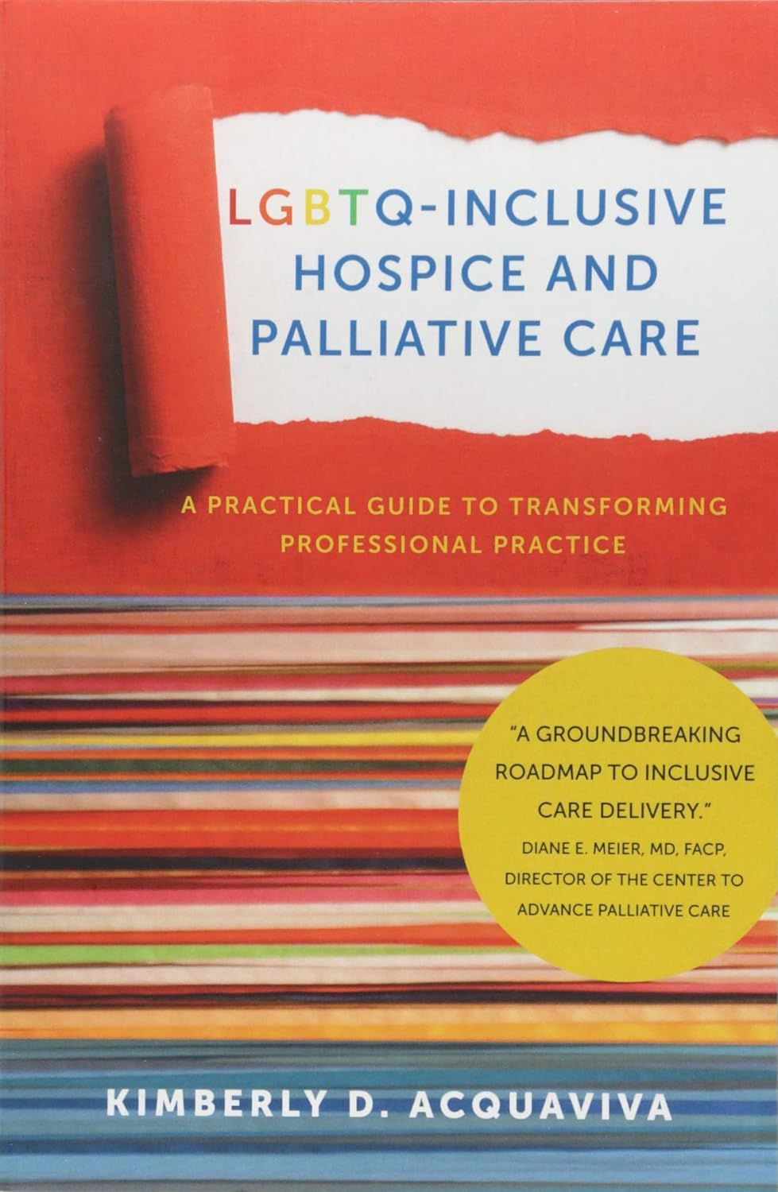
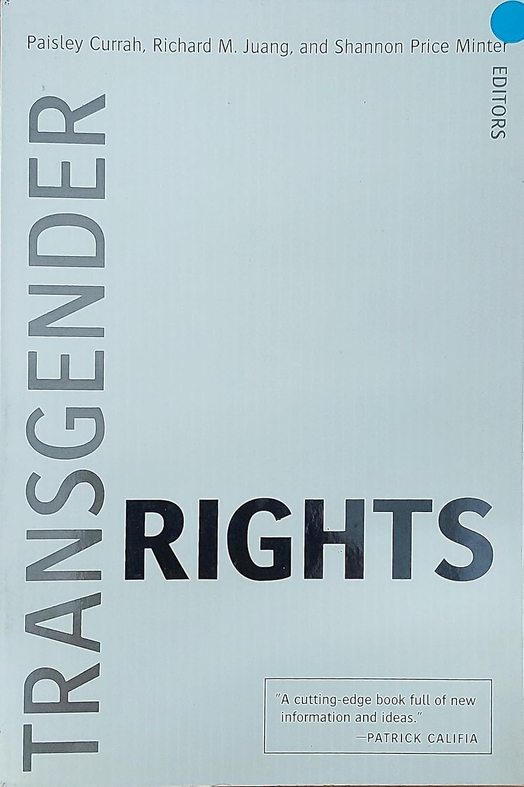
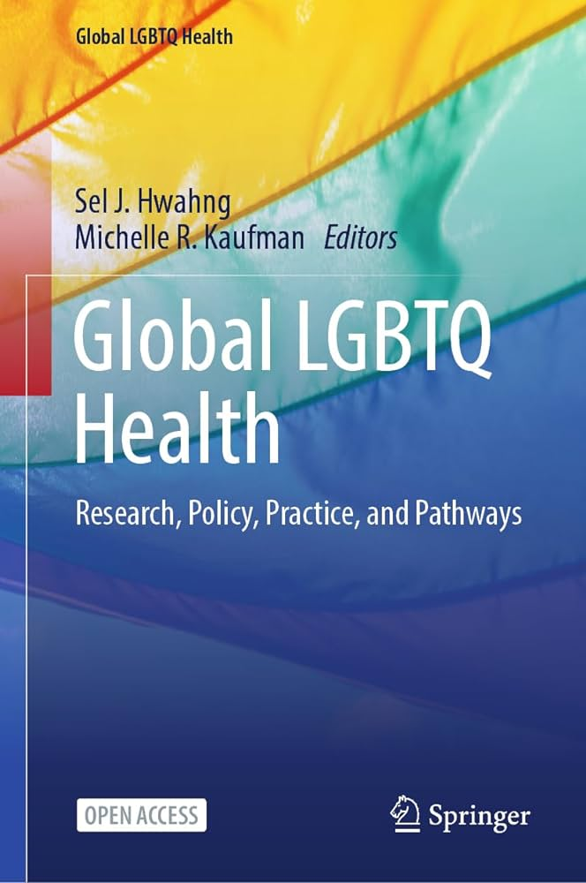
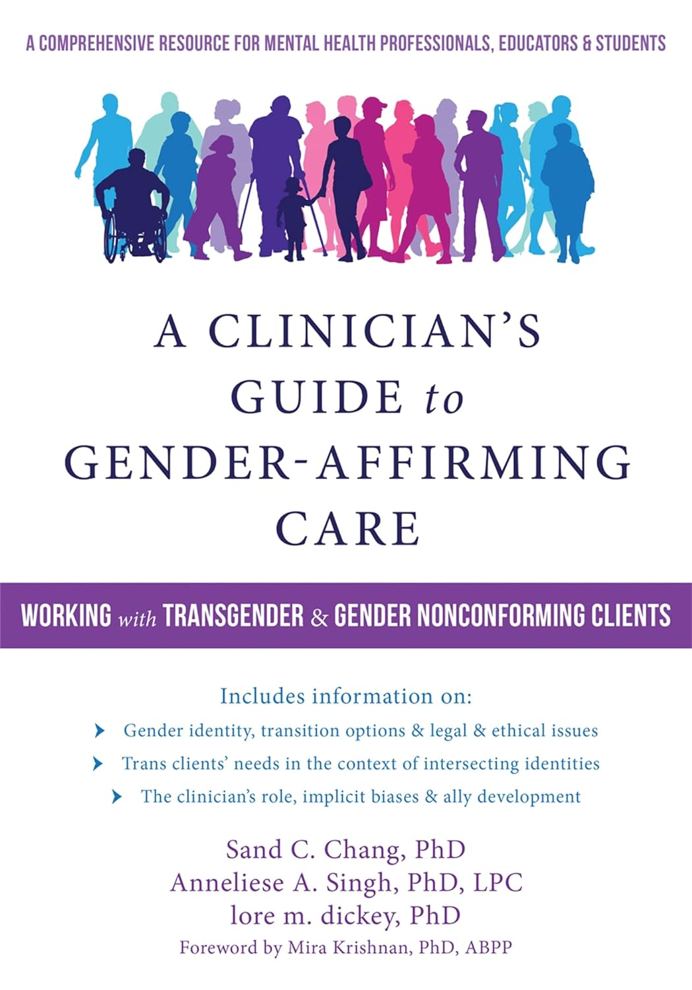
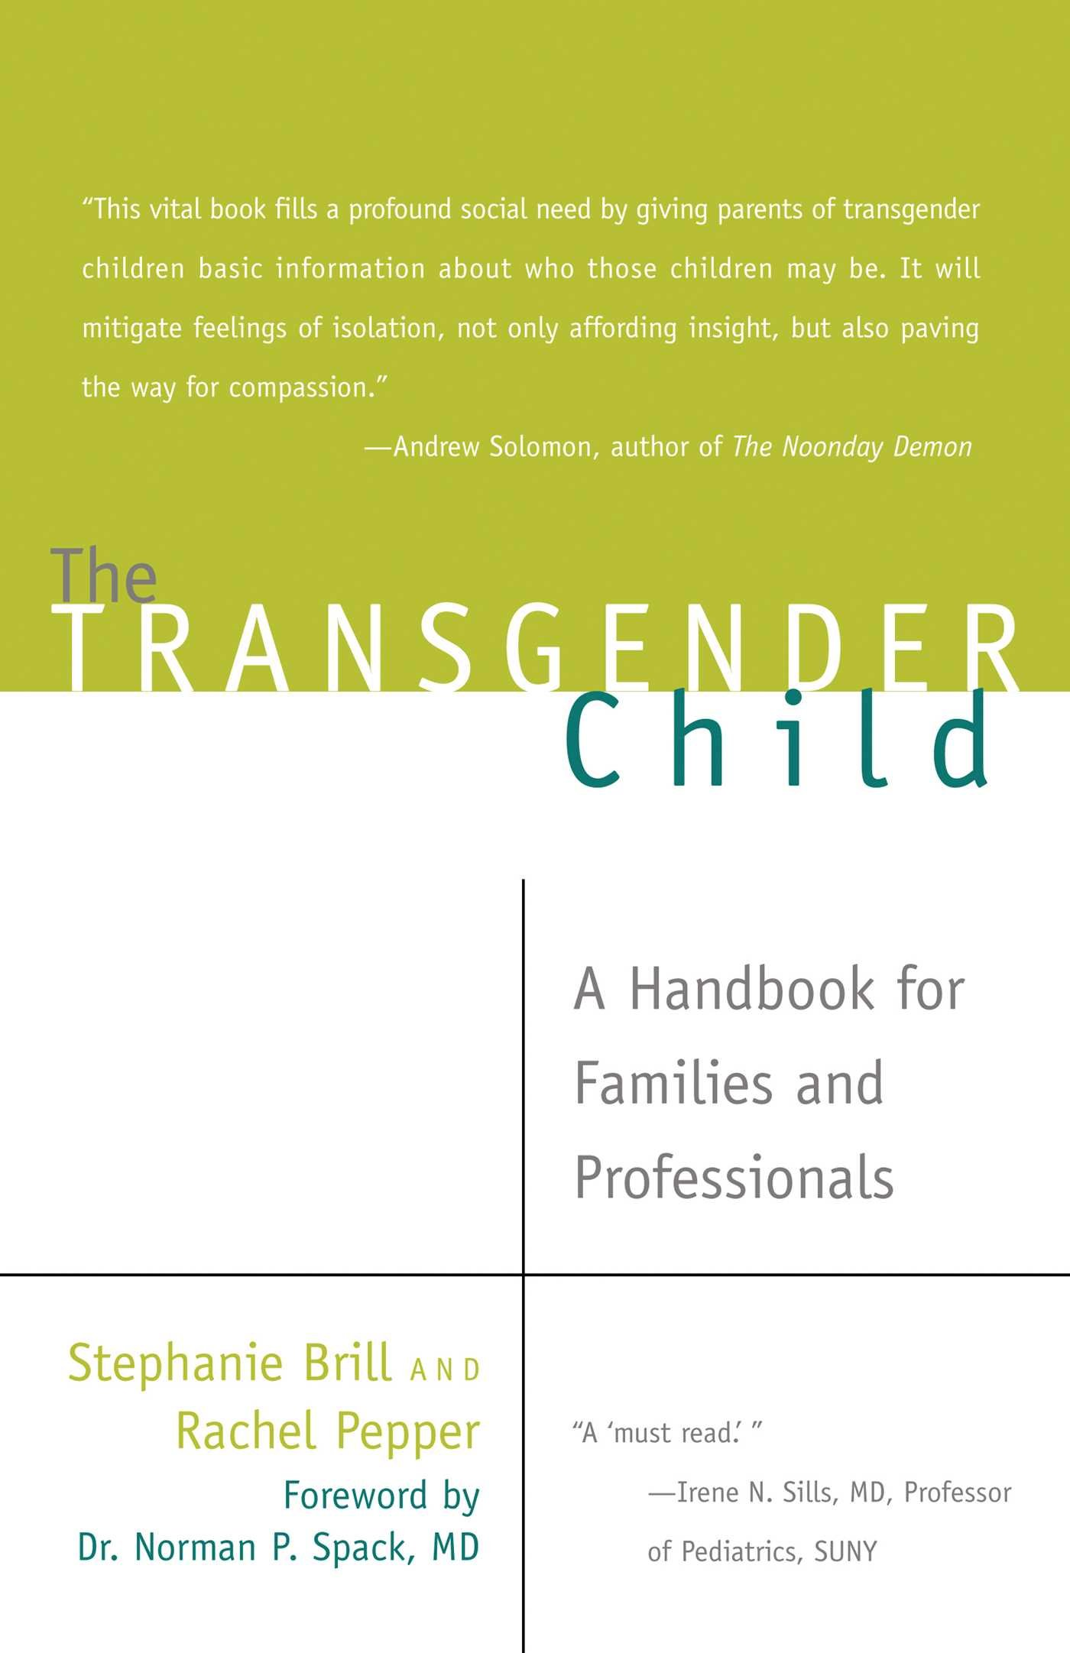
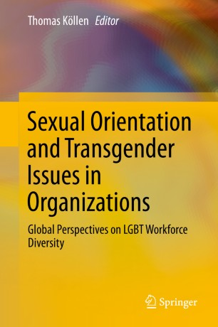
Notes:
So, why are we here today and why has so much been invested in learning more about sexual and gender diverse populations?
Because we have come to such a better understanding of the roles of minority stress and the impact it has on the health and well-being of marginalized people. So we’ve seen a wealth of information over the years and concentrated efforts to develop guidelines and guardrails on how to address these needs and provide care.
And importantly we’re investing more time in the intersection of these identities with others, including Indigenous and 2-Spirit people, individuals of color, and recognizing the variable needs across the lifespan.

Slide 4
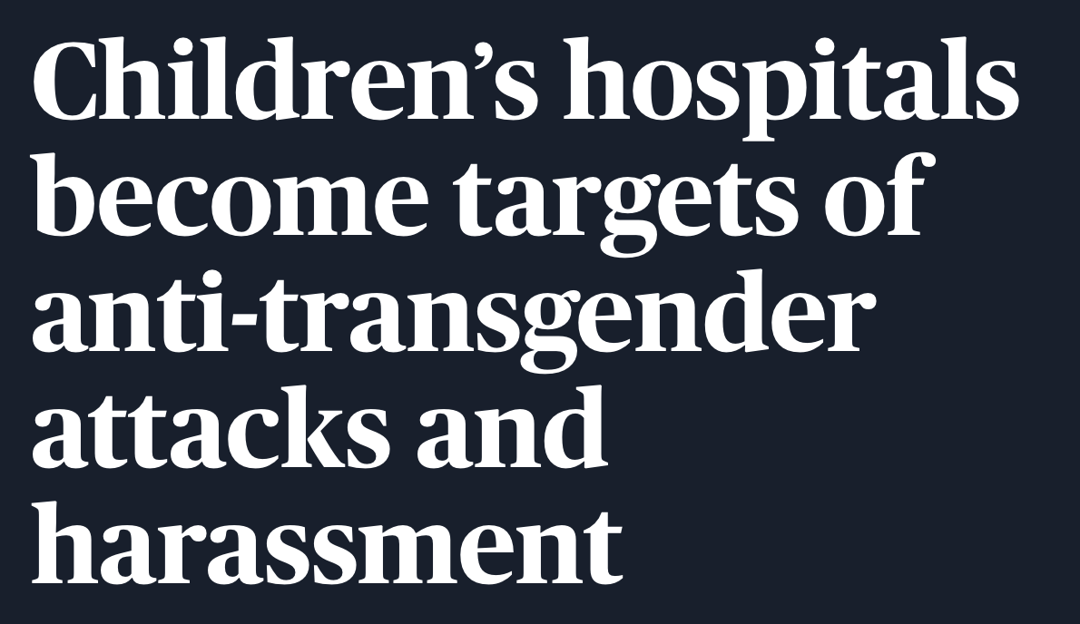
Notes:
But not all of it has been reassuring. If you’ve watched the news at all, you know that there has been a groundswell of efforts (both here in the US but also around the world) to limit the ability of these communities to live their authentic lives.

Slide 5
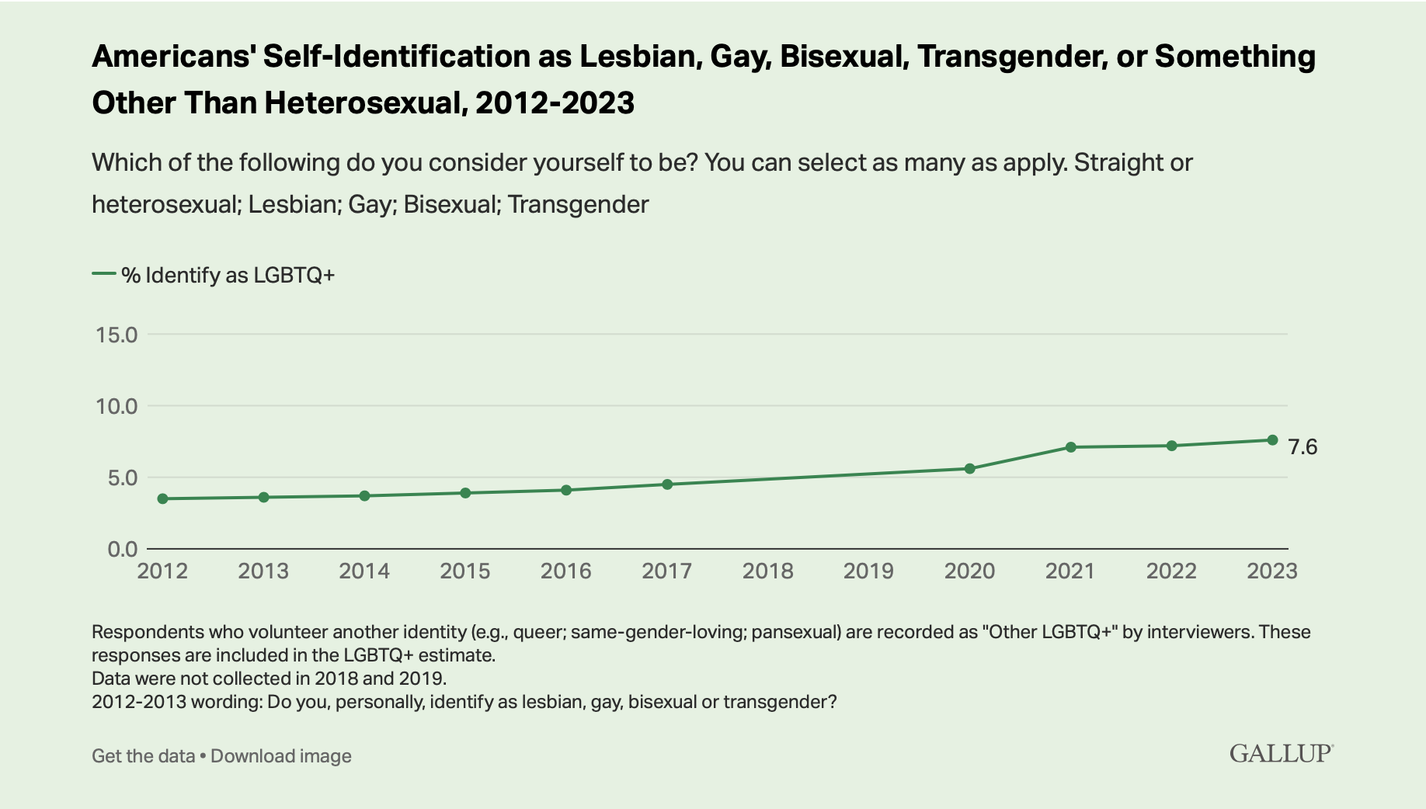
LGBTQ+ Identification in U.S. now at 7.6%
Bisexuality makes up the largest proportion of the LGBTQ+ population
More than 1 in 5 Gen Z adults and 1 in 10 millennials identify as LGBTQ
>1.6 million people ages 13+ identify as transgender in the US (at least 0.6-0.9%)
Gender expansive identities are more frequent among younger people
1.8% of American high school students identify as transgender
Up to almost 3% of high school students identify as gender diverse in some communities
Gallup. https://news.gallup.com/poll/611864/lgbtq-identification.aspx. Accessed 4 May 2024.
Flores, et al. The Williams Institute. 2022.
Johns, et al. MMWR. 2019, Grossman, et al. J GLBT Fam. 2006.
Notes:
Compare those numbers to 0.3% w/ Type 1 DM and 0.15% SLE
In some areas, particularly larger urban areas, up to 10% of high school students may identify as gender diverse
These results are based on aggregated data from 2023 Gallup telephone surveys, encompassing interviews with more than 12,000 Americans aged 18 and older. In each survey, Gallup asks respondents whether they identify as heterosexual, lesbian, gay, bisexual, transgender or something else. Overall, 85.6% say they are straight or heterosexual, 7.6% identify with one or more LGBTQ+ groups, and 6.8% decline to respond.

Slide 6
Kronk, et al. J Am Med Informatics Assn. 2022.
Notes:
And you may think well what does all of this have to do with my own practice and the lives of average SGD Americans?
Well, 20% of LGBT people overall and almost half of transgender people report discrimination on the basis of their identity when engaging with the healthcare setting, and almost a third of trans people avoided seeking care when they needed it

Slide 7
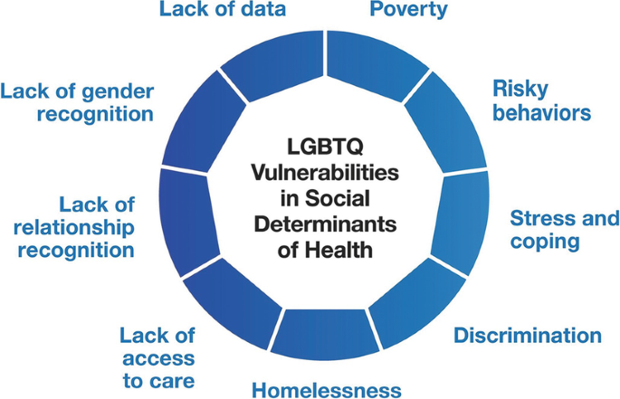
Adolescent disparities
Compared to their cisgender peers, transgender and gender expansive youth experience:
2-3 x increased risk for anxiety, depression, self-harm, suicidal ideation, and suicide attempts
2-4 x increased risk of substance misuse
Heightened risk of HIV and other STIs
Overall poorer health
Disproportionately high rates of school-based peer victimization
Higher likelihood of maltreatment from parents and caregivers
Up to 45% higher rates of homelessness and higher rates of discrimination within the shelter system
Notes:
Peer victimization during adolescence predicts increased depression, suicidality, and rates of HIV and STIs in LGBTQ young adults.

Slide 8
Concepts & Terminology
Notes:
There is no such thing as universal terminology

Slide 9
Core Terminology
Sex: Also known as “sex assigned at birth.” Tends to be based on the appearance of external anatomy at birth and may or may not align with gender identity or gender expression
Source and context of this definition is important and impacts mutability
Gender: A social construction; in a binary model, would refer to constructs of masculinity and femininity as defined by a given social order
Gender identity is not inherently defined by sex
Socially agreed upon biologic criteria
Not just a single, clear variable
Notes:
With regard to sex, we often implicitly make assumptions about how exactly this is defined. But the context matters.
sex --> predictions about gender, how someone moves through the world, the functions and interests they have, expectations about relationships with other people, the roles they take in reproduction, etc.
These aspects of biology directly impact development of cultural norms, expectations for navigating about one's life and navigation about social interactions and activities of daily living, etc.

Slide 10
Terms
Transgender
Non-Binary
Genderqueer, Gender Non-Conforming
Gender Diverse / Gender Expansive / Gender Minority
Cisgender: Gender identity aligns with sex assigned at birth
Transgender: Describes a person whose gender identity, or internal sense of their gender, differs from that assumed by their sex assigned at birth

Slide 11
Building Blocks of a Core Holistic Framework
Sexual Orientation
Gender Identity
Intersectionality
Mental Health & Stigma
Affirming Terminology
Resilience Considerations
Identities
Behaviors
Bodies
Anatomy/Organ Inventory
Medication Counseling
Pregnancy Potential
Screening & Surveillance
Surgical Considerations
& Complications
Sexual Behaviors
Pregnancy Risk (eg REMS/ iPLEDGE)
Comprehensive Sexual History
STI Risks & Prevention
Notes:
So much of this terminology has been conflated. The LGBTQ population is NOT monolithic and is extensively diverse. We have to be clear about who and what exactly we’re talking about in research, policy, etc.
And so I emphasize what I call the dimensions of personhood as distinct concepts with specific implications for care and general well-being.
For those of us who are dermatologists, we do all of this in the ipledge registration process for isotretinoin whether we realize it or not:
Identity determines how we counsel in an inclusive fashion and informs the reason why we struck the conflation of gender and pregnancy potential
Body determines whether someone should be registered as capable of pregnancy or not
Behavior determines whether contraception is needed

Slide 12
Avoid Assumptions and Remember the Difference
Sex / Sex assigned at birth
Gender Identity
Gender Expression
Sexual Orientation / Attraction (Physical vs Emotional)
Sexual Behavior

Slide 13
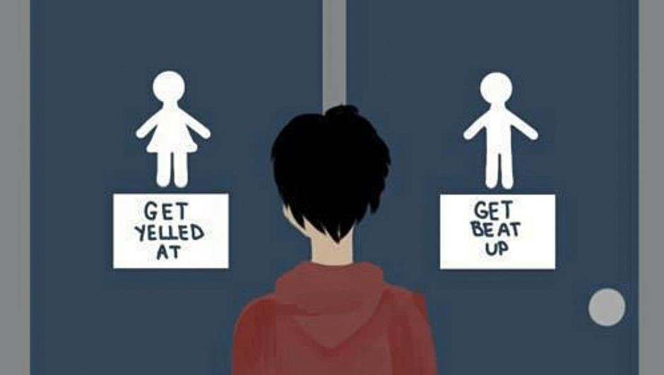
Gender Dysphoria
Strong and persistent distress or impairment with physical sex characteristics or ascribed social gender role that is incongruent with persistent gender identity
Not all gender diverse people experience dysphoria
Mitigated, in part, through gender affirmation

Slide 14
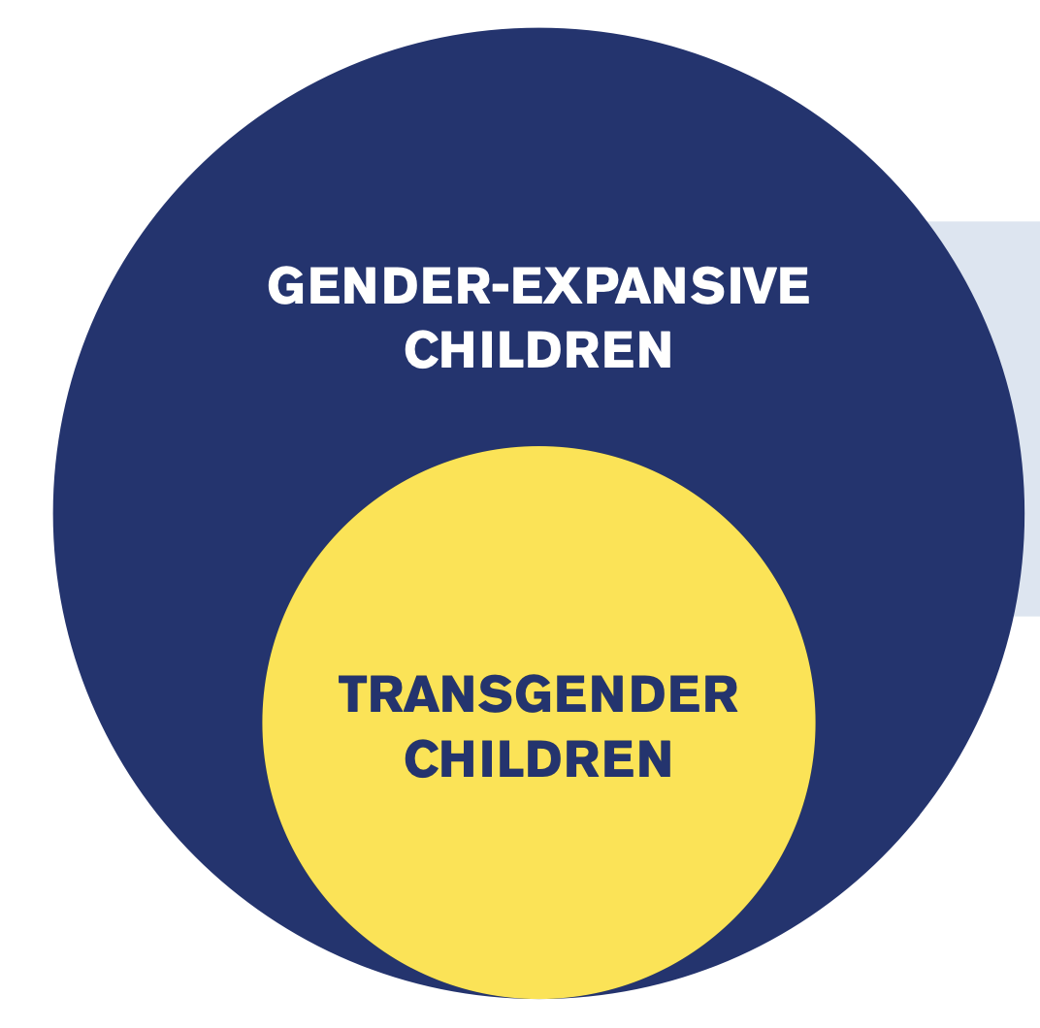
Key differences
HRC Foundation. http://hrc.im/supportingtranschildren. 2016.
Notes:
Being transgender is one way of being gender-expansive, but not all gender-expansive children are transgender.

Slide 15
Gender Affirmation
Social affirmation
Name change, pronouns, gender expression
Legal affirmation
Modifying gender markers on government documents
Medical affirmation
Gender-affirming hormone therapy or pubertal suppression
Surgical affirmation
Vaginoplasty, facial feminization surgery, breast augmentation, phalloplasty, minimally invasive procedures, etc
Psychological / Self-Affirmation
Internally affirming one's own identity
Refers to decisions, behaviors, or interventions that affirm a gender expansive person’s gender identity
Not all people who are gender diverse will desire all (or any) domains of gender affirmation
Notes:
And the last bit of terminology, when we talk about gender affirmation, we’re referring to any behavior or interventions …
INSERT GENDER DYSPHORIA HERE

Slide 16
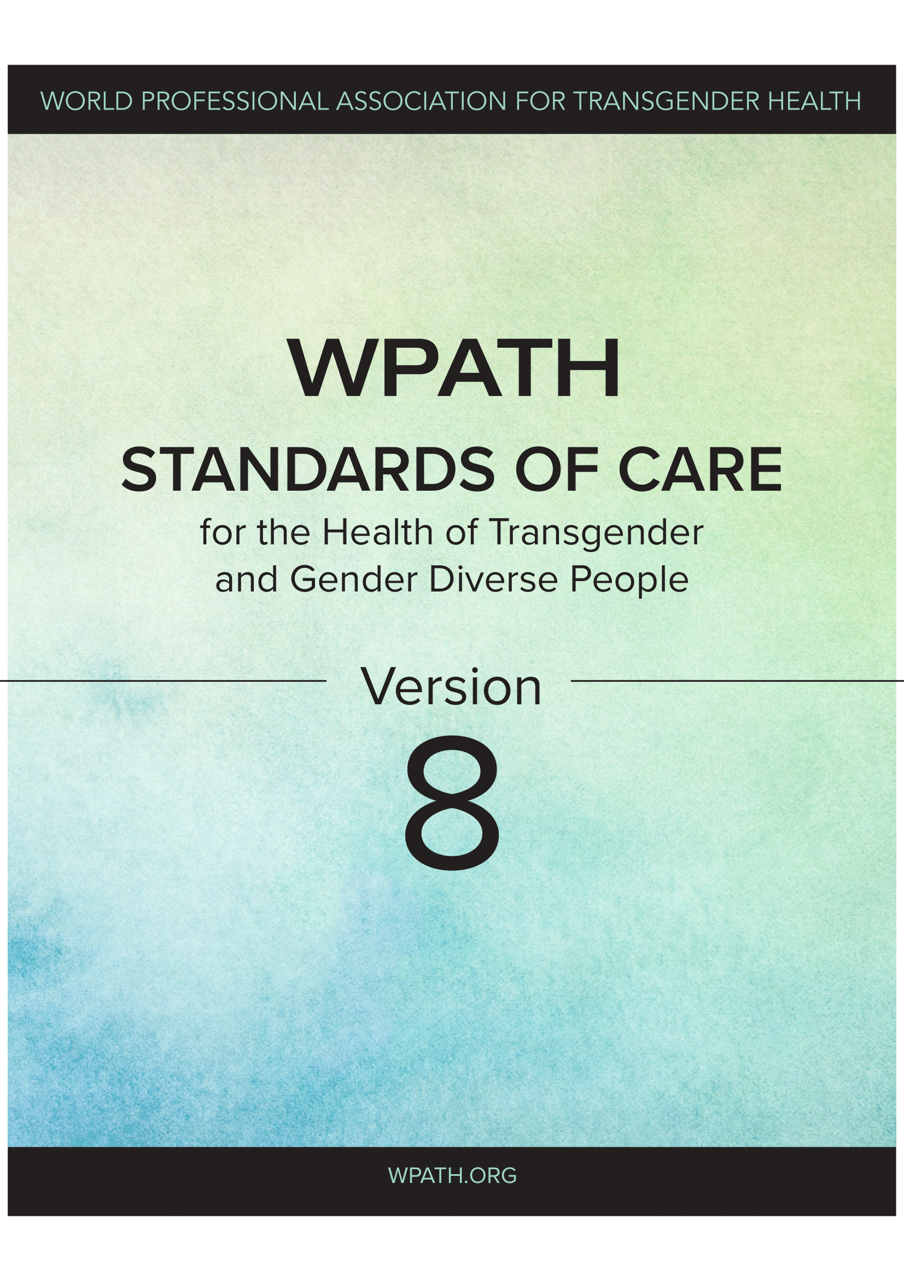
Standards of care
Background
Key points & updates
World Professional Association for Transgender Health (WPATH): Leading global professional organization dedicated to research and development of guidelines for the care of gender diverse people
The first Standards of Care (SOC) released in 1979
Version 8 released Fall 2022
Evidence consists of a series of systematic reviews identifying almost 400 studies; final SOC-8 referenced more than 1400 studies
Rigorous Delphi process
A “one-size-fits-all” model does not work for everyone
Care should be individualized
The only form of gender-affirming care for children before puberty is social support
Prior to receiving gender-affirming care, adolescents’ gender identity experience should be “marked and sustained over time”
Along with a model of informed consent, a timeline for care can be determined as best for the individual
Notes:
RCTs difficult in this population. 90% of the current practice of medicine is not based on RCTs.

Slide 17
If I remember anything, what should it be?
Transgender people are 67 times more likely to attempt suicide than the general population
HOWEVER
Studies consistently demonstrate that gender-affirming care significantly reduces this risk by up to 73 percent
Notes:
Transgender people are 67 times more likely to attempt suicide than the general population.
BUT
Studies consistently demonstrate that gender-affirming care significantly reduces this risk by up to 73 percent.

Slide 18
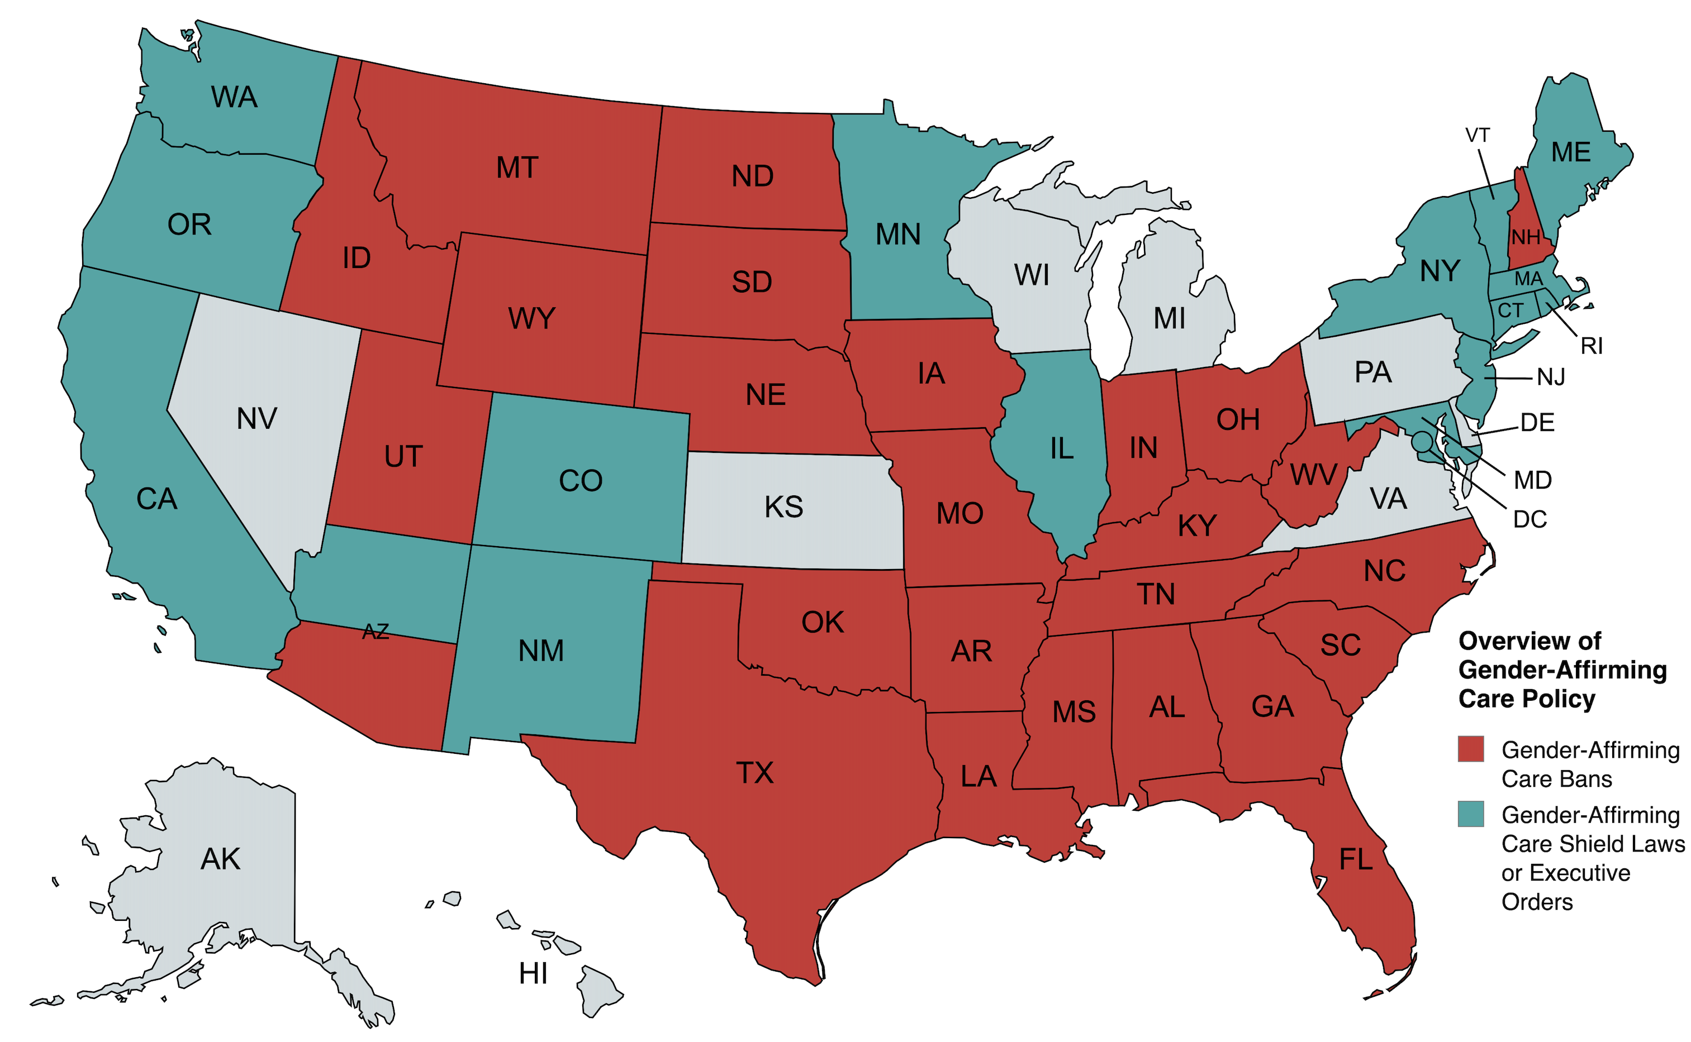
State of the landscape in 2024: CARE BANS
Ban temporarilyand/or partially blocked by court order
Ban permanently blocked by court order
Lawsuit filed / pending / ongoing
Ban not yet in effect
Shin, et al. JAMA Derm. 2023.
Movement Advancement Project.
Created with mapchart.net.
Data current as of 9/17/2024.
Notes:
This is an overview of legislative activity in the US – I love talking about the global landscape but that’s an entire lecture all its own!
SCOTUS hearing arguments this Fall in the Tennessee case.
SCOTUS: Idaho, Tennessee, Kentucky → appeals courts working toward SCOTUS (4 appeals from 3 states)
May say as early as TODAY whether they will take up one of these cases
TN enacted bill to stop adults from helping minors access care. First in the nation. The bill, which goes into effect on July 1, prohibits adults “from intentionally recruiting, harboring, or transporting” a transgender minor for medical care within the state of Tennessee.
Missouri AG now investigating therapists and social workers.
Some of the good news is that lower courts are ruling in favor of transgender people, but they are getting overruled as the cases make their way to the federal circuit; KY and TN, for example, in the 6th circuit, which is lifting temporary blocks on the bans going into effect. Florida Ladapo case → great reading.
Montana – First state to issue any sort of restrictions targeting social transition. “State property, facilities, or buildings may not knowingly be used to promote or advocate the use of social transitioning or the medical treatments prohibited by the law.”
Hard to know for sure how this directly impacts derm though the language in the bills could absolutely be construed as such depending on who is interpreting that language.

Slide 19
What do these laws mean?
Most laws apply regardless of payor source
Language is variable but broadly applies to surgery, hormone therapy, and puberty blockers (though does not explicitly exclude other treatments)
Largely applies only to physicians, nurse practitioners, and physician assistants
Does not apply to intersex / DSD, simply rendering a diagnosis of gender dysphoria, or to the provision of mental health care or basic information
“Aiding or abetting,” “Referring”
Increasingly common in state language
Intentionally vague and may be more broadly applicable
Pharmacy / point-of-dispensing
Dermatologic care (??)
Shin, et al. JAMA Derm. 2023.
Notes:
“Overcompliance” — so much fear that folks are refusing care that may not even be illegal. Bans are intentionally vague and want to inflict far-reaching damage.
Pharmacies telling parents they will not dispense, even before the laws go into effect. Or not dispensing to patients even when they are subject to the grandfather clause exemption.

Slide 20
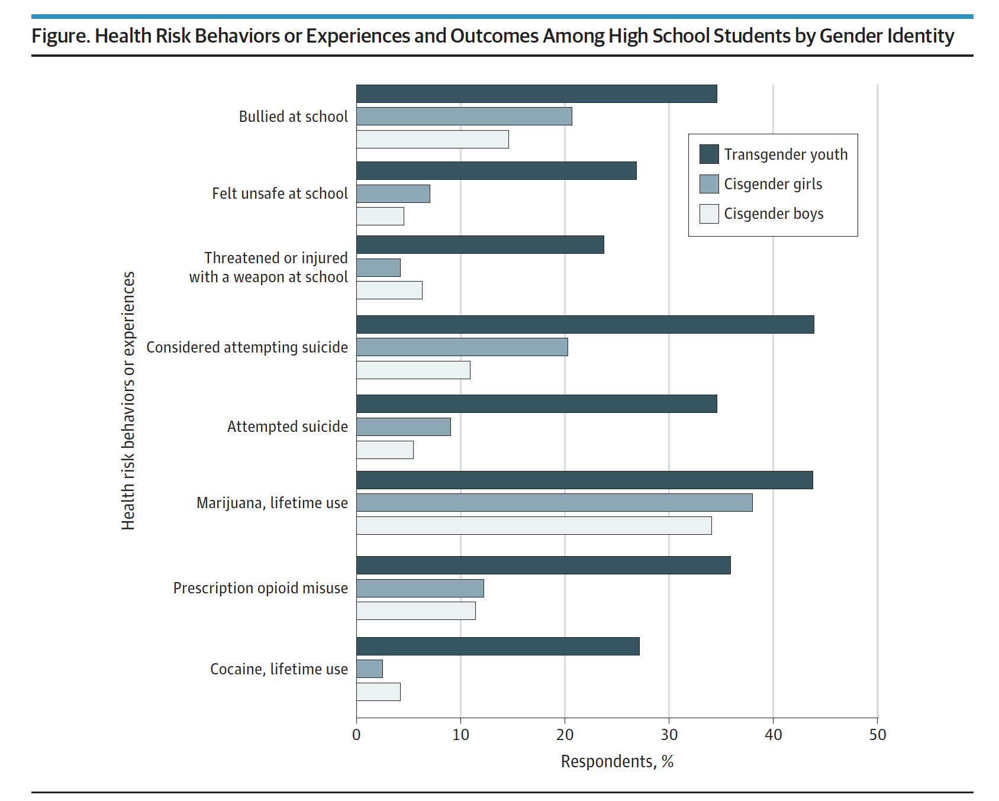
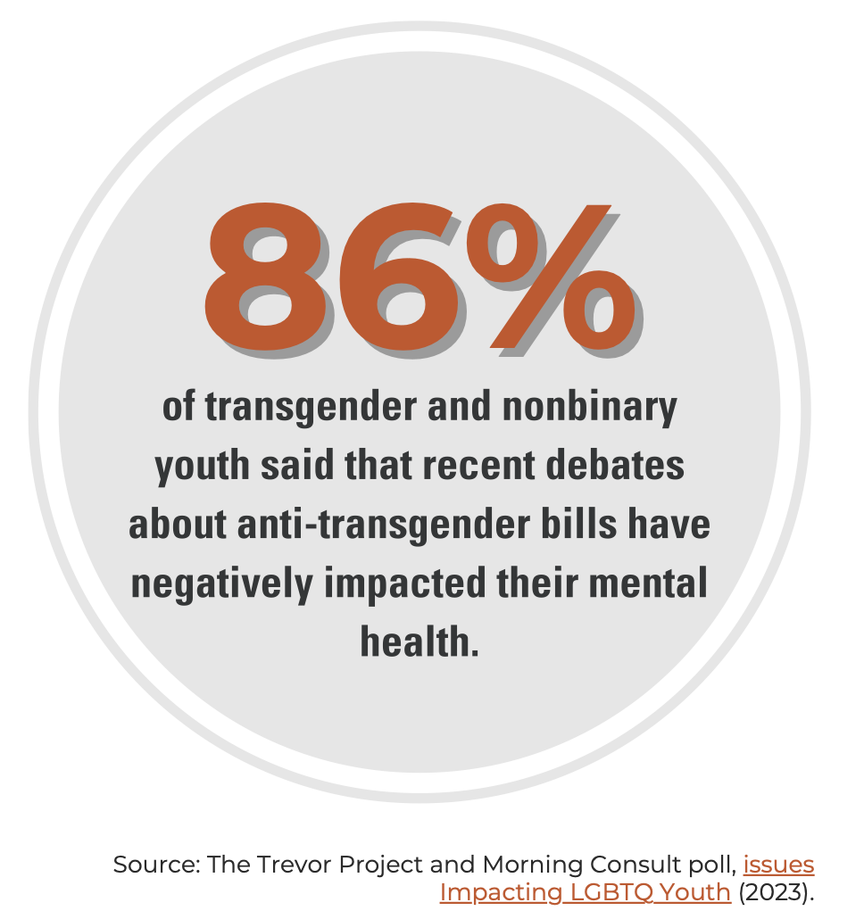
FBI. Hate Crime Statistics. https://www.fbi.gov/how-we-can-help-you/more-fbi-services-and-information/ucr/hate-crime. Accessed 1 June 2024.
Barbee, et al. JAMA Pediatrics. 2021.
Notes:
2017 Youth Risk Behavior Survey in 10 US States and 9 large urban school districts.
CDC data: Youth Risk Behavior Survey showing that 1 in 3 LGB students bullied on school property or online in the last year. Rate for straight students was half as high.

Slide 21
“Decisions about care should remain within the confines of the physician-patient relationship, guided by strong medical evidence and the best interests of the individual patient.”

Slide 22
Creating the Welcoming & Affirming Space
Notes:
So how do we go about welcoming individuals of all sexual and gender identities?

Slide 23
Essentials of the Safe & Welcoming Space
Cultivate an Affirmative Treatment Approach
Elicit the Patient’s Story
Use the Right Language
Avoid Missteps
The Art of the Apology
Autonomy

Slide 24
The Clinic Environment
Staff & Personnel Training
Gender Neutral Restrooms & Facilities
Medical Records & Data Collection
Ensure Privacy
Affirming and Non-stigmatizing Artwork, Periodicals, & Media
After-Visit Summaries and Follow-Up Messaging
Notes:
KNOW WHERE THE RESTROOMS ARE Artwork, etc – Magazines should not perpetuate stereotypes or further notions of cisheteronormativity only; just like they should appeal across cultures, ethnicities, and skin types
Does artwork convey only one view of a family unit?
After-visit summaries? Other aspects of how your practice functions that you might not realize in the context of the face-to-face clinic conversation?
AGA – have a great conversation but then your after-visit summary undermines everything that you just said

Slide 26
Considerations for the History
Confidentiality is one of the most important considerations
Bound by local/state laws and institutional policy
Transparency regarding what is and is not documented in the EHR
Time alone with the adolescent is critical
Safe space for questions, builds trust, facilitates ownership over the adolescent’s health and active participation
Confirm name and pronouns at each visit
There is no such thing as a “good” assumption
Open-ended questions
Labels don’t necessarily align with behaviors; “What do you consider ‘having sex’?” “What are the genders and bodies of your partner(s)?”
Gender neutrality (both patient and peers)
Maintain gender neutrality in communication but echo the patient’s language and preferred terms once those are clear
3rd person and peer-focused language
“Are any of your friends having sex?”
Notes:
Remember that affirming the parents is just as important. Hearing doctors reiterate language, concepts, and terms is reassuring and validating.

Slide 27
Missteps Can Cause Harm

Slide 28
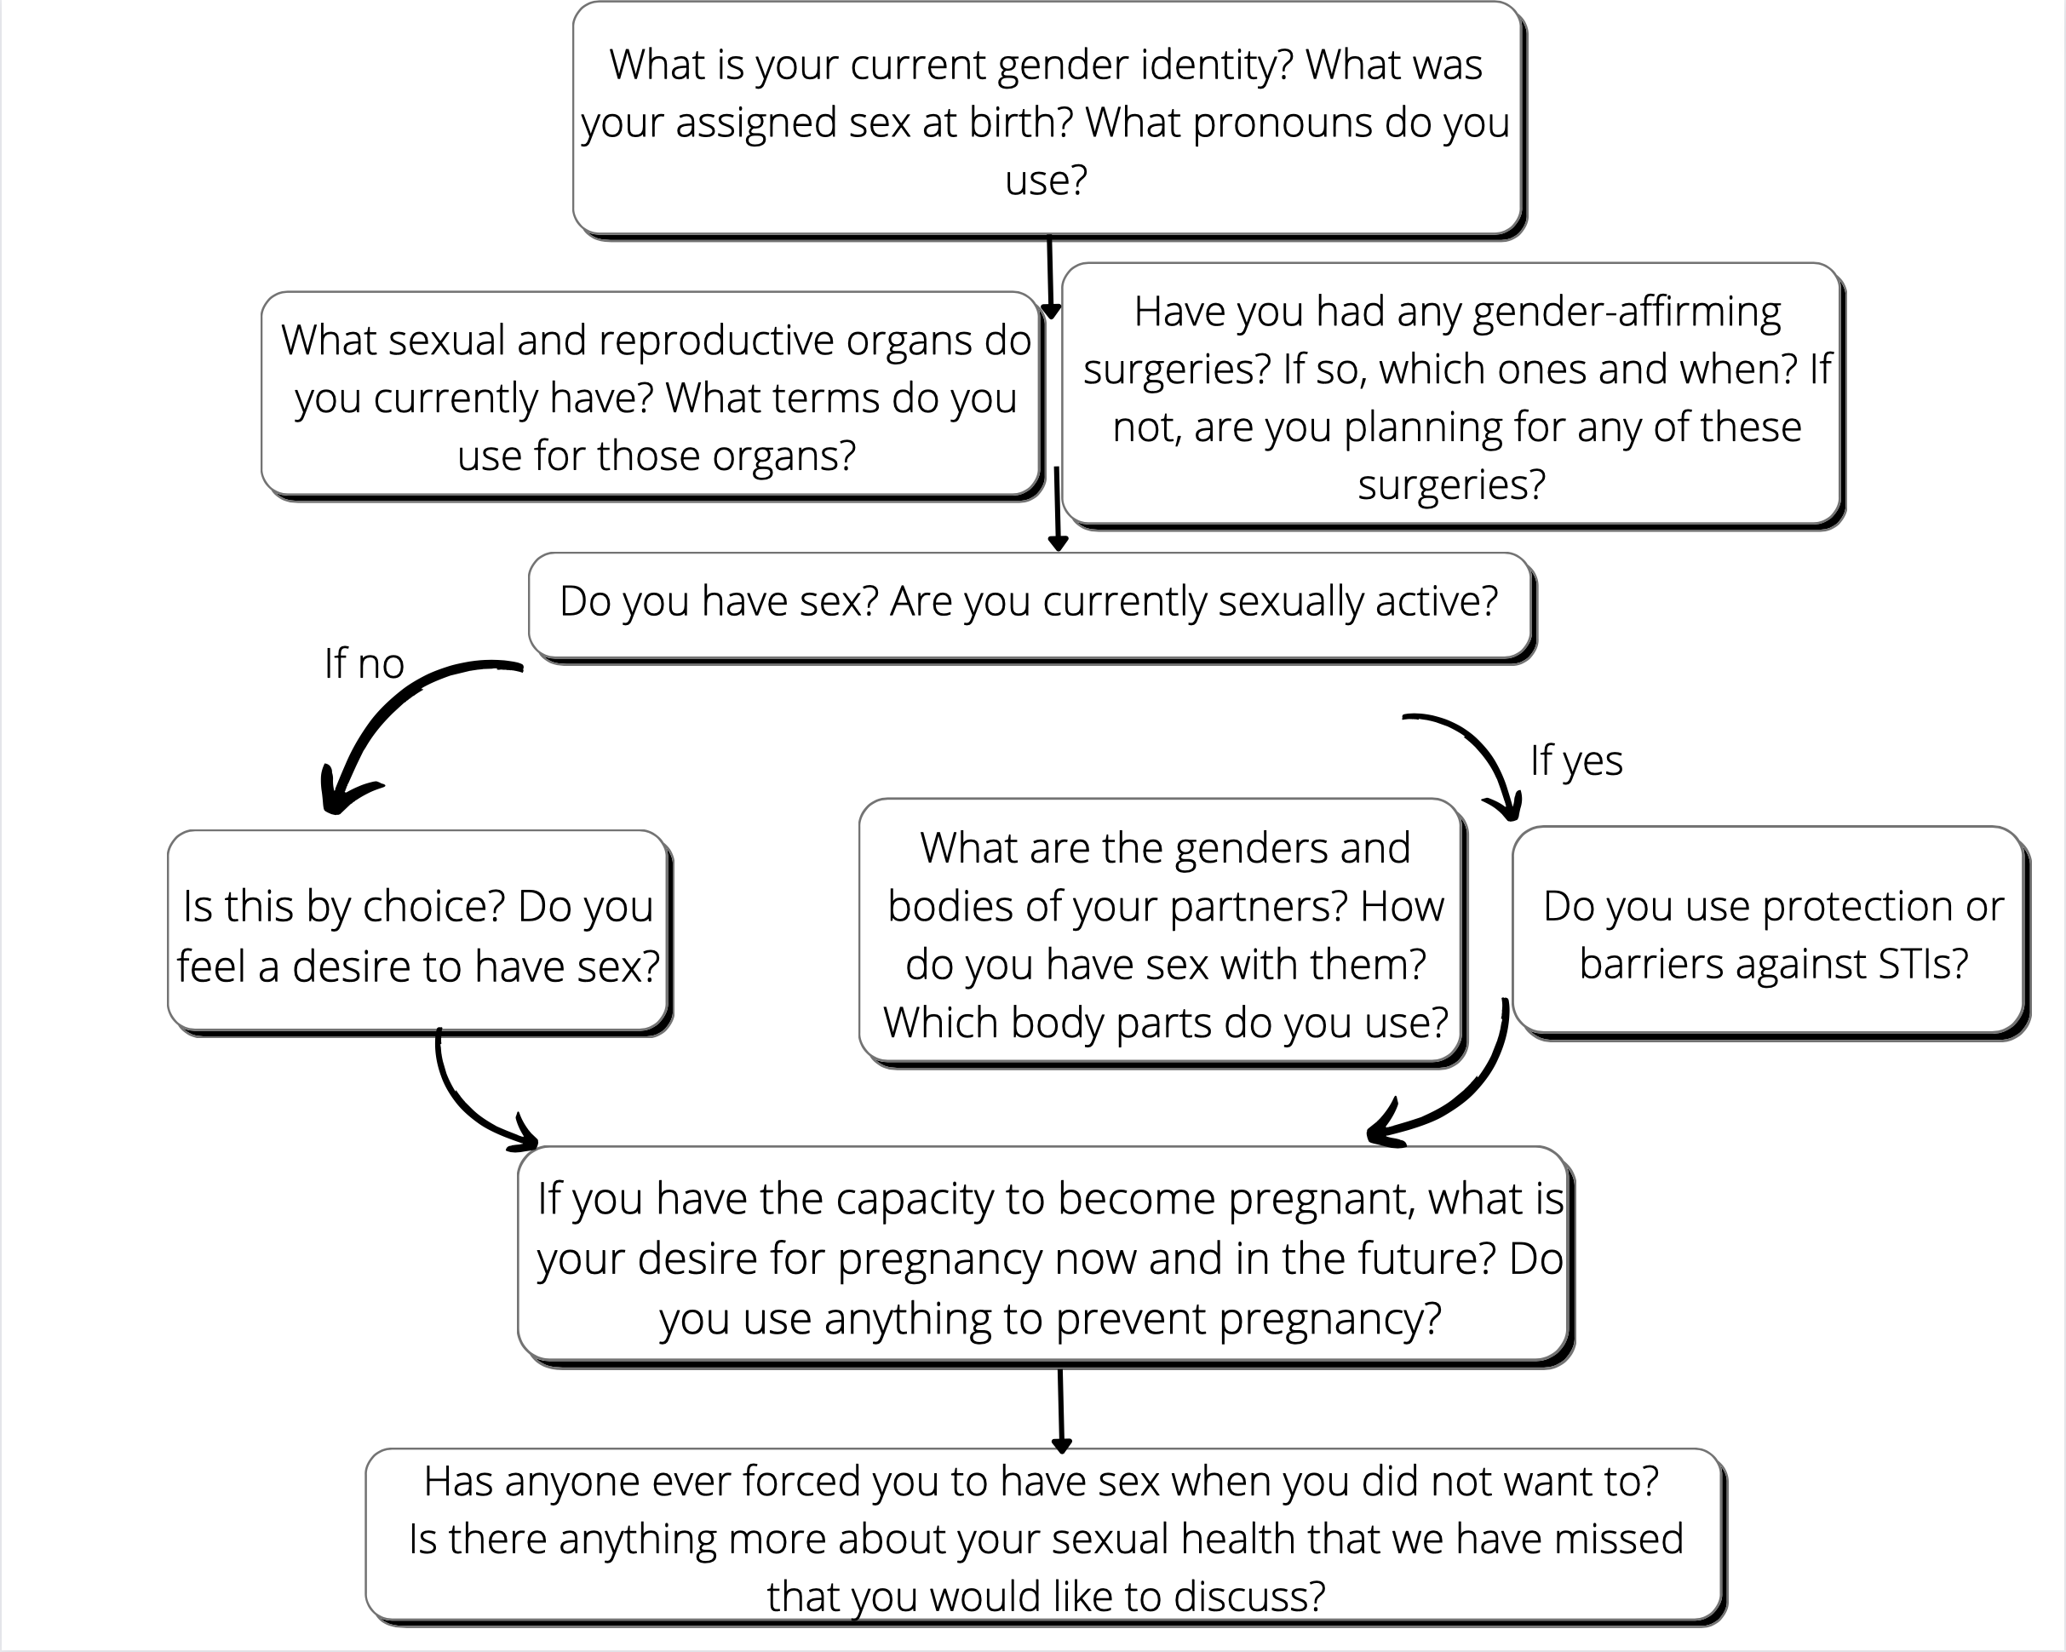
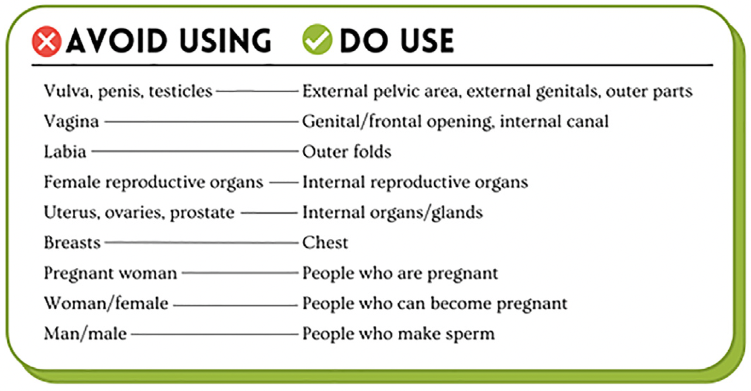
Gender & sexual history: a conversational approach
Gao, et al. Dermatol Clin. 2023.
Krempasky, et al. Am J Obstet Gynecol. 2020.
Notes:
You will see an infinite number of suggestions in terms of how to have these conversations and framing these questions. Find the style that works best for you and comes most naturally.

Slide 29
Clinical focus masculinizing therapy & acne

Slide 30
Masculinization
Testosterone
All testosterone preparations currently used in the US are “bioidentical”
Chemically equivalent to the testosterone secreted from the human testicle
Usually IM testosterone cypionate or testosterone enanthate (weekly)
Also topical testosterone formulations: gel, cream, patch
Testosterone pellets
Lasts 3-4 months
Implanted into subdermal fat on buttocks
Notes:
For our older adolescents and young adults ----

Slide 31
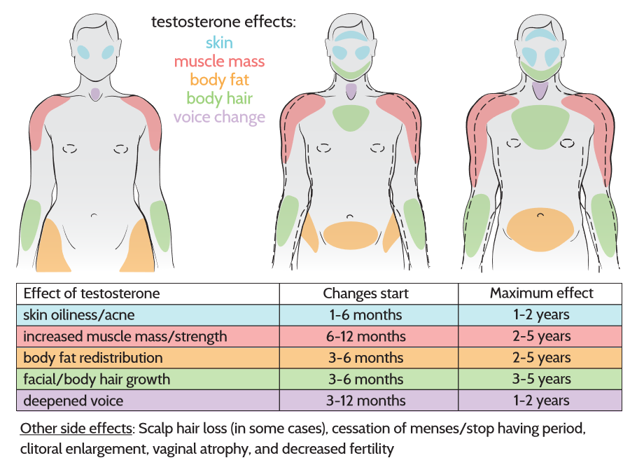
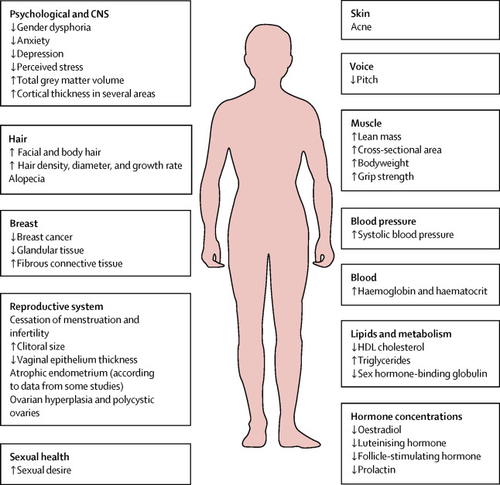
Masculinizing Hormone Therapy
Derm effects: Alopecia, acne, changes in sweat/odor production, increase in body hair, vaginal dryness and atrophy
Treatment:
Usually IM testosterone cypionate weekly
Other formulations available
Gel, cream, patch, pellets
Tetzlaff, K. Patient’s guide to transgender, trans, & gender diverse health. 2015.
UCSF. Center of Excellence for Transgender Health.
Notes:
WPATH: Ample time of living in desired gender role and after one year of hormonal treatment (for surgery)

Slide 32
As many as half to >90% of patients on T develop acne on the face, back, and/or chest within 4 months
Gradual increase in cumulative incidence over 24 months
Risk factors: Higher BMI, high serum T levels (>630 ng/dL), current smoking, younger age, history of acne prior to initiating MHT
Persists! Small European survey study: Almost 70% of patients reported mild-moderate acne after an average of 10 years of testosterone
Park, et al. JAAD. 2019.
Nakamura, et al. Endo J. 2012.
Wierckx, et al. J Sexual Medicine. 2014.
Thoreson, et al. Jama Derm. 2021.
Notes:
55 trans men
Looked at serum T levels (high/low defined by the median 630 ng/dL) but did NOT look at T dose.
One study suggested that virilization effects were dose-dependent earlier, but the dose dependence decrease the longer on T

Slide 33
Acne and Mental Health & Well-being
Transmasculine persons more likely to have mental health comorbidities
Transmasculine individuals diagnosed with moderate to severe acne more likely to report clinically significant depression and anxiety compared to those without
With moderate to severe acne
71% depression, 39% anxiety
Without moderate to severe acne
40% depression, 16% anxiety
Transgender men have increased odds of healthcare avoidance relative to transgender women
Braun, et al. JAMA Dermatol. 2021.
Kcomt, et al. SSM-Pop Health. 2020.

Slide 34
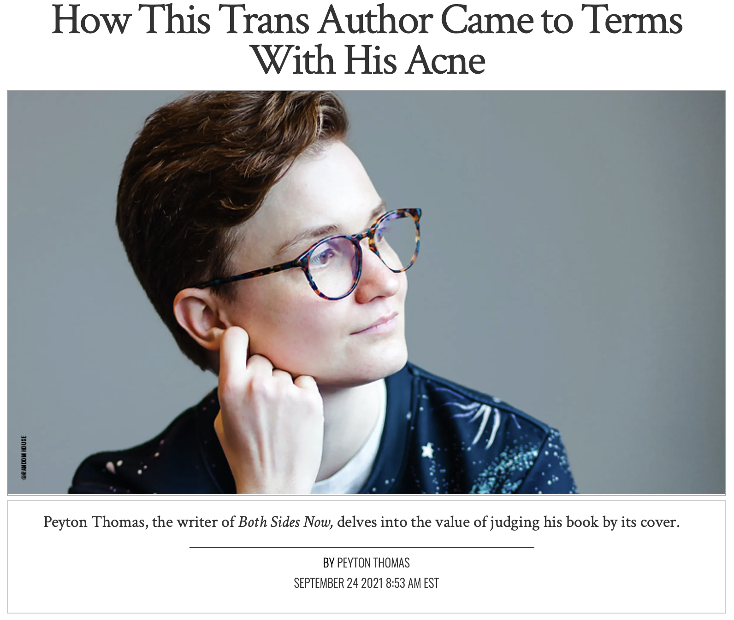
“No one is spared. And though it’s a fairly inconsequential side effect…I’m not too proud to admit that I spent a little over a year taking a very low dose of testosterone, in part because I feared the onslaught of acne.”

Slide 35
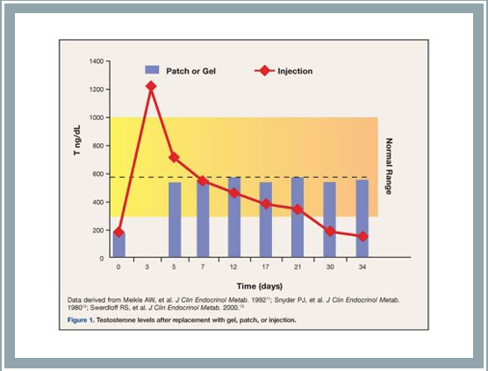
Management approach: key points for transmasculine individuals
In general, approach to management is similar to that of cisgender individuals with the following important pearls:
Oral spironolactone should NOT be used in the setting of testosterone as it will antagonize its gender-affirming effects
Topical clascoterone may be an option when topicals are desired and/or other agents are contraindicated
Consider evaluating serum testosterone level (>630 ng/dL may be associated with acne)
Contraception options may be considered as acne therapeutics, but agent selection should be carefully discussed in the context of patient’s gender affirmation journey and goals
In general, combined oral contraceptives do not prevent masculinization and can be used along with testosterone (though their use may trigger dysphoria for some transmasculine individuals)
Isotretinoin is often indicated and involves several unique considerations
Park, et al. JAAD. 2019.
Notes:
Consider topical clascoterone
Oral spironolactone should not be used
Consider evaluating serum testosterone level (>630 ng/dL may be associated with acne)
COCs do not prevent masculinization and can be used along with testosterone
COCs may trigger dysphoria

Slide 36
Topical anti-androgens
Topical clascoterone cream
Novel topical androgen receptor inhibitor
2 phase 3 RCTs, double-blind and vehicle-controlled, 1440 patients (both male and female)
Results significant compared with vehicle at week 12
No significant systemic activity
Hebert, et al. JAMA Dermatol. 2020.
Notes:
2 clinical trials; both men and women; no gender diverse people specifically included.

Slide 37
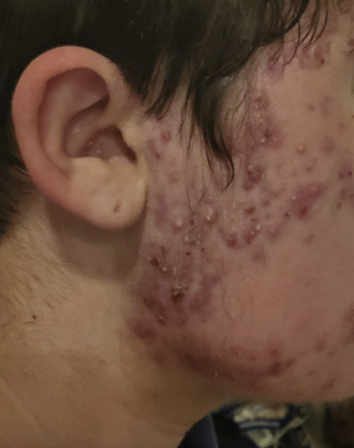
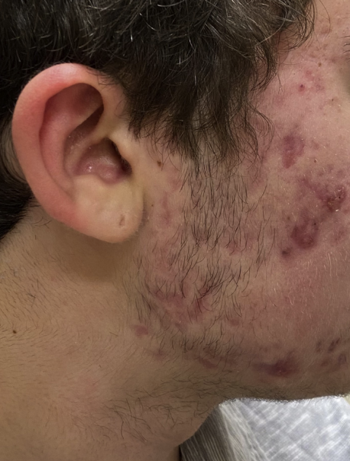
Lee, et al. JAAD. 2022.

Slide 38
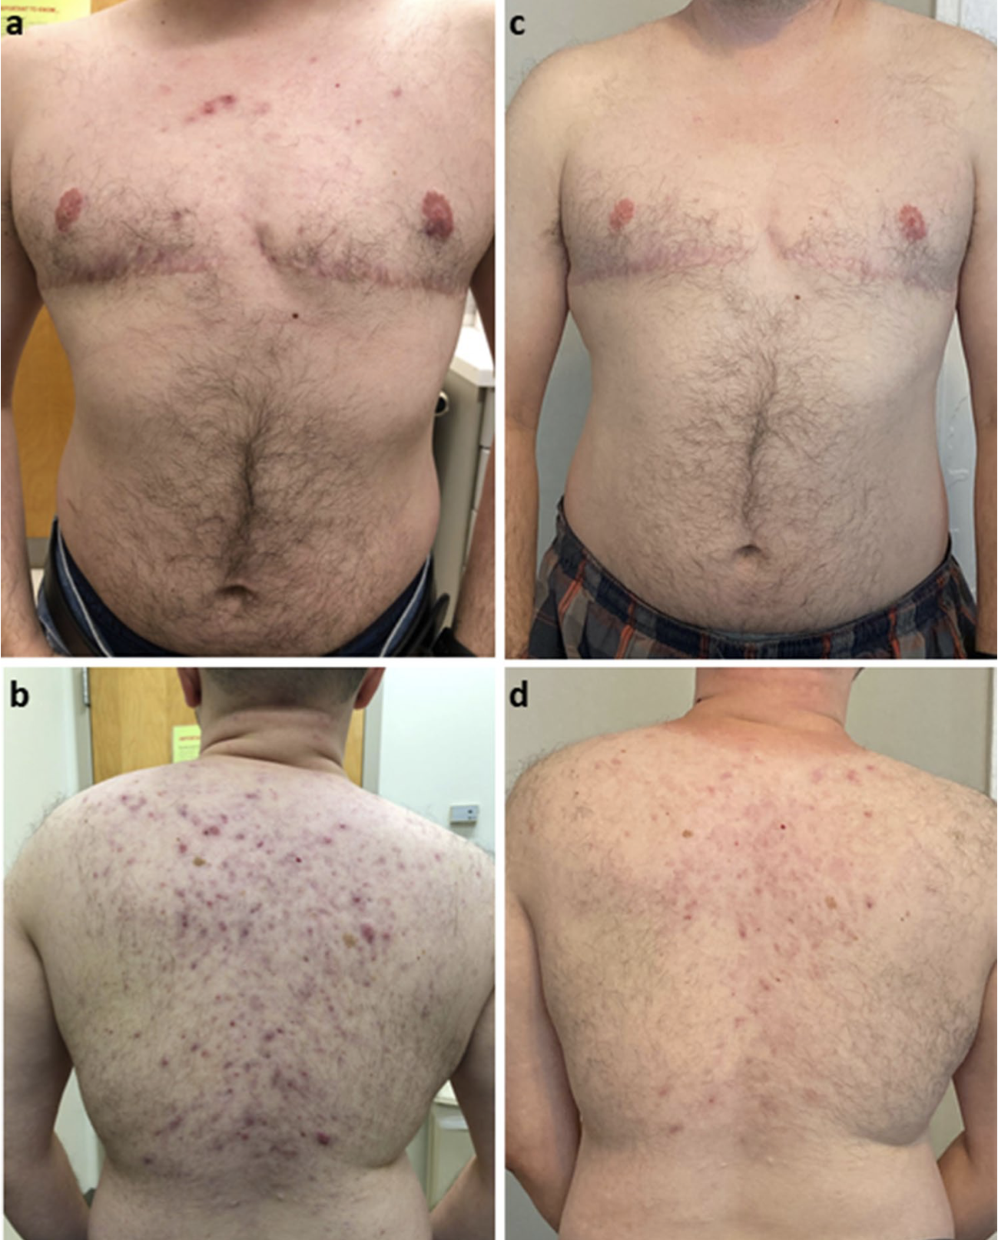
Isotretinoin: Pre / Post Therapy
Radi, et al. Am J Clin Dermatol. 2022.

Slide 39
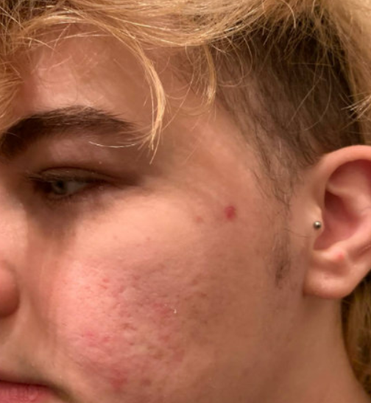
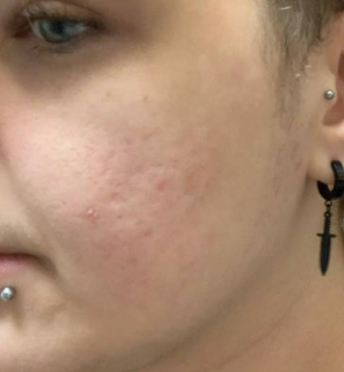

Slide 40
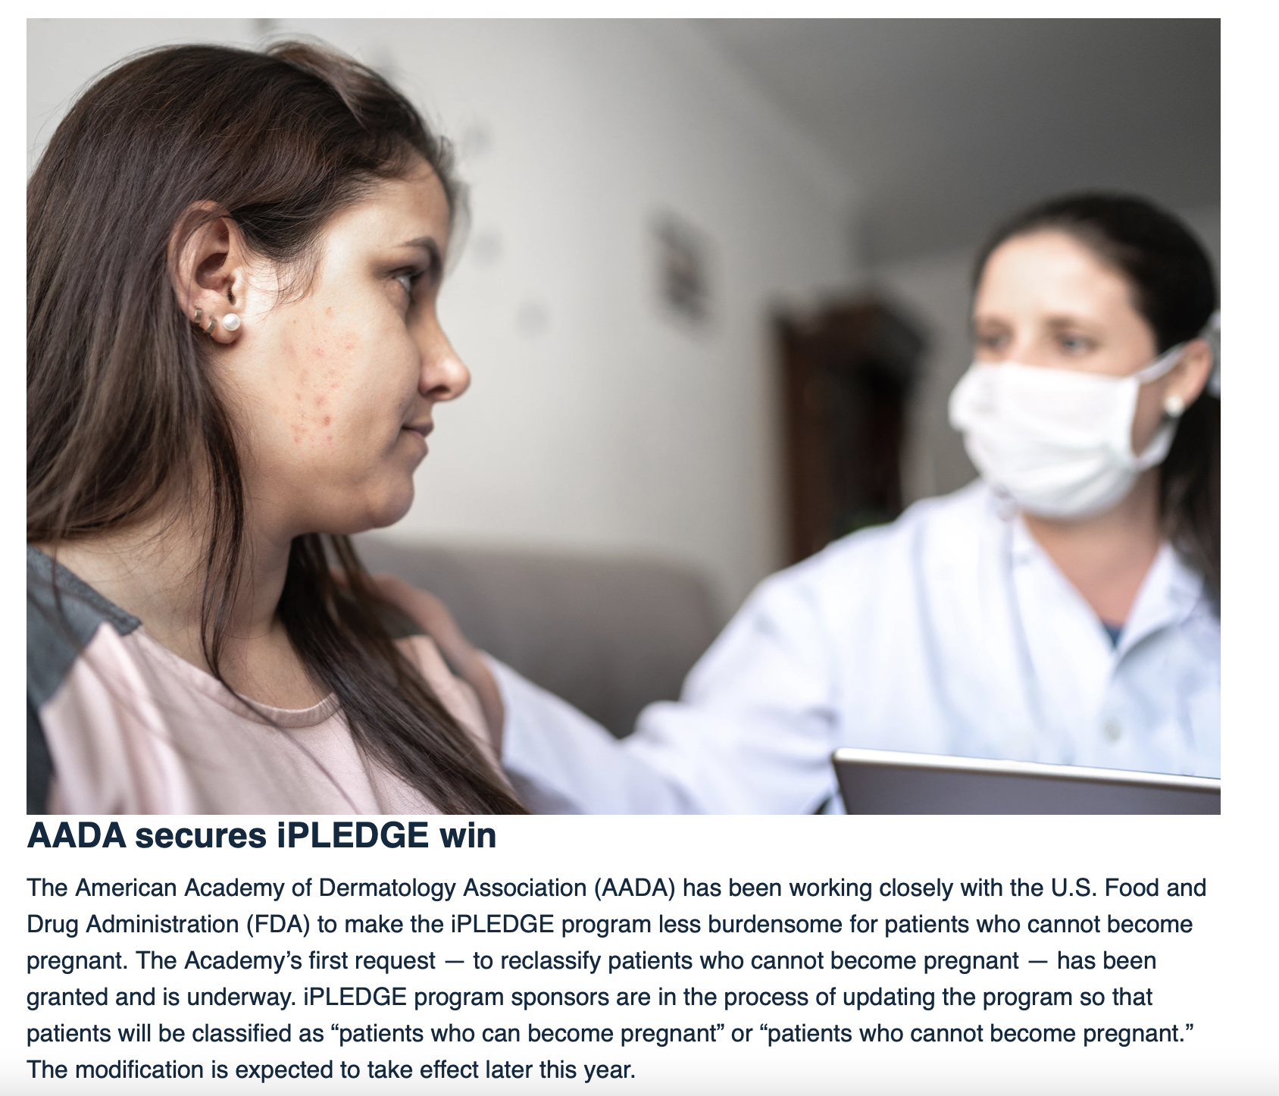
A New (?And Improved?) iPLEDGE
Years of tireless advocacy successfully removed the discriminatory patient categorization model
Now 2 categories instead of 3:
Patient who can become pregnant
Patient who cannot become pregnant
Guidelines for selecting category continue to inappropriately conflate sex and gender

Slide 41
Isotretinoin: Pregnancy Risk and Contraception
Take a comprehensive, sensitive, and inclusive sexual history
Any penile-vaginal intercourse with individuals who produce sperm? If not, abstinence is an option.
Recognize that sexual partners may also be gender diverse – be conscious of terminology and clarify behaviors
More than half of trans men engage in sexual practices with pregnancy potential
25-50% of trans people want to use their natal reproductive capacity
If contraception is needed, the same options applicable to cisgender people are still available depending on the context of affirmation therapy, timeline, and goals
Testosterone is NOT contraception
Testosterone is not a contraindication to any form of hormonal or non-hormonal contraception
Krempasky. Am J Obstet Gynecol. 2020.
Stark. Contraception. 2019.
Chen. J Adolesc Health. 2018.
Light. Obstet Gynecol. 2014.
Notes:
Well, contraception may or may not be needed, and we should assess that by taking a comprehensive, sensitive, and inclusive sexual history.
Recognize that more than half of trans men engage in sexual practices with pregnancy potential. And 25-50% of trans people in general want to use their natal reproductive capacity.
If contraception is needed, the same options applicable to cisgender people are still available depending on the context of affirmation therapy, timeline, and goals. Really important is the fact that T is NOT contraception. Pregnancies have occurred in trans individuals taking T. While research is ongoing, T so far is not a definitive contraindication to any form of hormonal or non-hormonal contraception, and the choice should be patient-centered with a joint conversation between the dermatologist and the patient’s primary gender affirming providers.
While robust research on hormonal contraception in the setting of masculinizing hormone use is lacking, estrogen in combined hormonal contraception is not likely to significantly prevent masculinization. It may be useful to counsel patients regarding contraceptive side effects that may cause dysphoria or distress, such as potential chest/breast tenderness with hormonal contraception initiation.¹

Slide 42
Pregnancy and transmasculine individuals
Testosterone is not contraception
Cross-sectional survey of 41 transgender men who had been pregnant:
25 (61%) of transgender men reported using testosterone before pregnancy
5 of these 25 participants (20%) conceived while still amenorrheic from testosterone use
A third of pregnancies were unplanned
Light, et al. Obstet Gynecol. 2014.

Slide 43
Contraceptive Methods with Transmasculine Considerations
Krempasky. Am J Obstet Gynecol. 2020.
Bonnington, et al. Contraception. 2020.
Notes:
No evidence that OCPs significantly interfere with T levels or with most secondary sex characteristics
Just remember that the most appropriate contraceptive is ultimately the one chosen by the patient.

Slide 44
Isotretinoin
Comprehensive and confidential pregnancy potential and sexual behavioral history (must know genders and bodies of partner(s) as well as specific behaviors)
E.g. Receptive penile-vaginal intercourse with an individual who produces sperm
iPLEDGE no longer conflates gender identity with pregnancy potential
Acknowledge and discuss mental health intersections
Discuss any planning for invasive affirmation procedures
Mastectomy may be offered during adolescence (though very uncommon)
No change to existing consensus standards for laboratory monitoring
Normalize that pregnancy risk is assessed for everyone with capacity for pregnancy regardless of sexual activity (or the lack thereof)
Independent increased risk of depression in those identifying as SGD and those with acne; substantially increased risk in SGD people with acne
Evidence does not yet exist for an increased risk of hepatotoxicity in the setting of concurrent isotretinoin and testosterone use
Notes:
Current evidence points to non-issue for wound healing after systemic retinoids in the setting of more minor procedures but hasn’t been evaluated in the context of more invasive surgeries including phalloplasty, mastectomy, etc.

Slide 45
Adam’s journey
Referral: “18 yo with acne not responding to topical medications. On testosterone.”
Acne of face and trunk; major worsening 10 months ago though had baseline milder, comedonal acne since early adolescence
Therapeutic efforts: Salicylic acid, benzoyl peroxide, topical clindamycin, topical dapsone, tretinoin, adapalene, 2 courses of doxycycline each 6-8 weeks in duration over the last 6 months
Past Medical History & Medications
Generalized Anxiety Disorder
Buspirone
Major Depressive Disorder
Sertraline
Surgical History
Appendectomy, tonsillectomy, third molar extractions
Social Context
No tobacco, social EtOH and cannabis

Slide 46
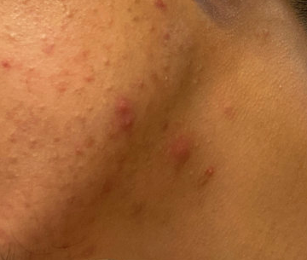
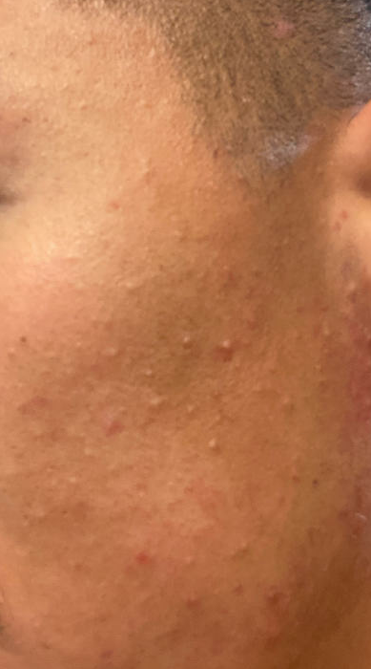
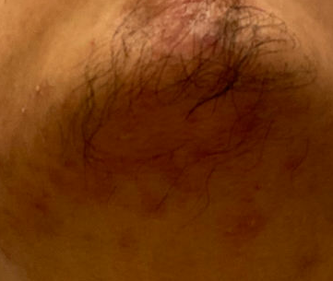
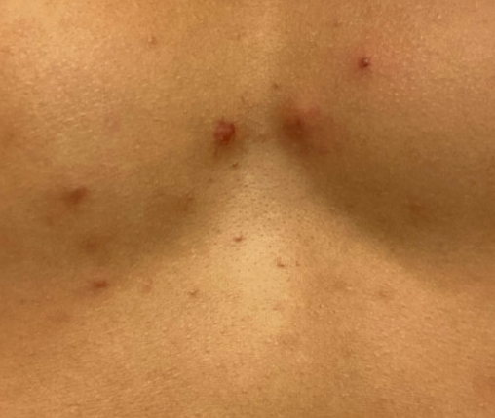
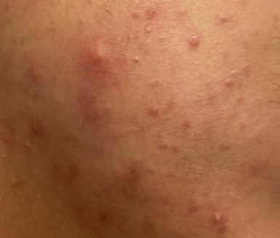

Slide 47
Gender affirmation history

Slide 48
Gender affirmation history
Assigned female at birth
Identifies as man; he/him/his pronouns
Started testosterone cypionate IM injection weekly ~1 year ago
Serum testosterone levels in normal / target range
Amenorrheic
Not currently sexually active though identifies as bisexual
Binds chest
No plans for surgical affirmation in the next year
Considering bilateral mastectomy within the next 2-3 years

Slide 49
Treatment approach
Jointly decided to start isotretinoin
Discussed with Adam’s primary gender clinician and psychiatrist
Registered in iPLEDGE as patient who can become pregnant
Registered as abstinent
Minimal dysphoria in the context of pregnancy potential though opted for serum pregnancy testing largely due to convenience
Initiated 40 mg daily isotretinoin

Slide 50
4 months later …
Improvement noted and uptitrated to 80 mg daily; fewer lesions and reduced frequency of breakouts
Reported that he is starting to pursue a new relationship with a non-binary partner who produces sperm
Brief treatment holiday while he discussed contraception with his primary gender clinician and was prescribed COCs (ethinyl estradiol and norgestimate)
iPLEDGE updated and treatment continued
Side effects: Xerosis, occasional headache, minor arthralgias, minimal hypertriglyceridemia

Slide 51
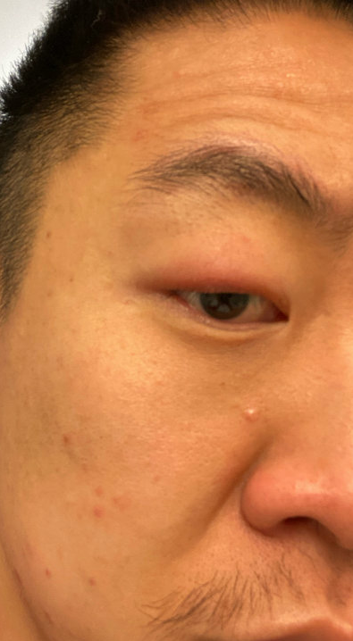
The latest
Completed cumulative weight-based dosing (200 mg/kg) in ~ 7 months
Substantial improvement though continues to have a few lesions at the lower cheeks and jawline
Started pulse therapy at 20 mg 3 times weekly and is completely clear after ~2.5 months of this dosing
Current plan is to continue this dosing for 4-6 months and then reassess
I tend to emphasize lower doses for longer periods of time and am increasingly turning to pulse dosing

Slide 52
Other Transmasculine Dermatologic Considerations
Chest Binding Complications
Compression of breast tissue to aid in affirmation. May or may not precede top surgery.
As many as ~ 90% of transmasculine individuals chest bind with a similar number experiencing side effects
Complications (>75%) include dermatophytosis, pruritus, miliaria, contact dermatitis, scarring
Non-derm complications: Rib fractures, pneumothorax
Top surgery implications
Informal Resources for Patients:
https://transguys.com/features/chest-binding
https://pointofpride.org/chest-binder-donations/
https://helloclue.com/articles/cycle-a-z/chest-binding-tips-and-tricks-for-trans-men-nonbinary-and-genderfluid
Peitzmeier, et al. Culture, Health, Sexuality. 2017.
Monstrey, et al. Plastic Reconstruct Surg. 2008.
Notes:
Binding: Compression of breast tissue in order to create a flatter appearance of chest; one study showed that up to 87% of TM people had engaged in chest binding
Derm complications seen in more than 75% in one survey study. 9 in 10 people experienced at least one negative effect from binding; 8 of 10 felt it was important to discuss this with healthcare provider but only 3 in 20 sought medical care for binding-related issues.
May need to delay until after surgery if top surgery is planned given that this can impact the skin’s elasticity and have impacts on healing. Can make performing a mastectomy more complex.

Slide 53
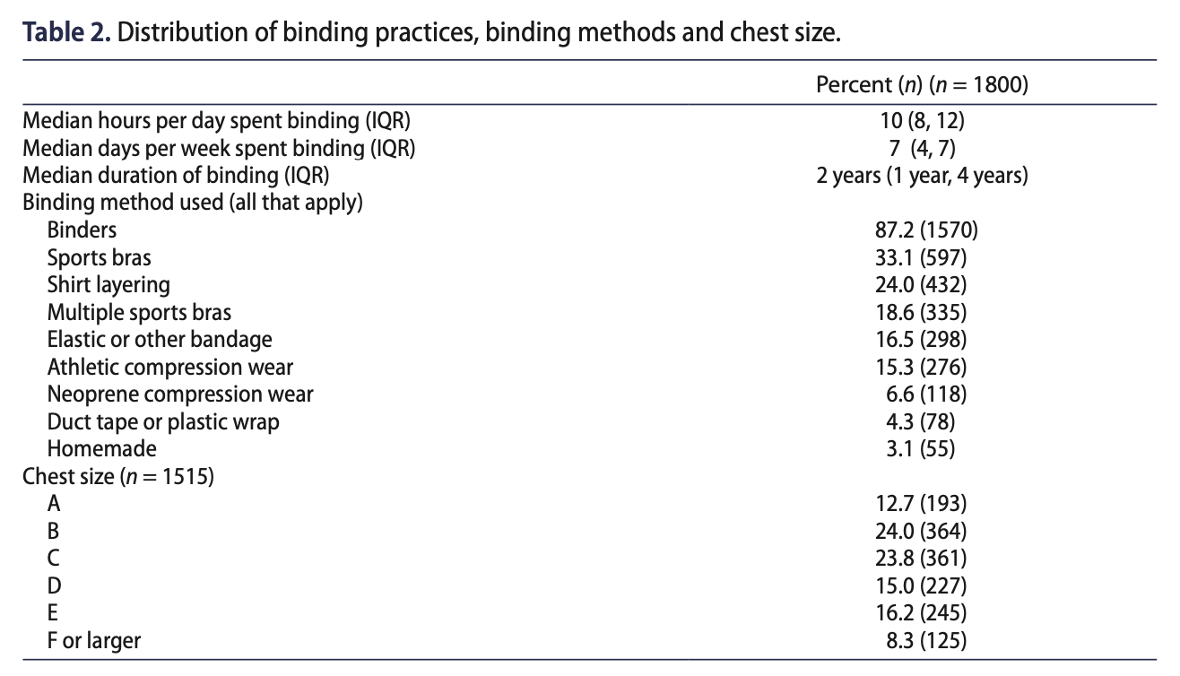
Notes:
Just looking at elastic, duct tape/plastic wrap, and homemade binders → about a quarter of patients are binding suboptimally

Slide 54
Chest Binding
General Recommendations
Use professional chest binding garments
Binder should be correctly sized
Binder should be removed while sleeping
Binding should be limited to no more than 8-12 hours per day
“Off-days” are recommended
Elastic bandages, duct tape, plastic wrap should be avoided
Monstrey, et al. Plastic Reconstruct Surg. 2008

Slide 55
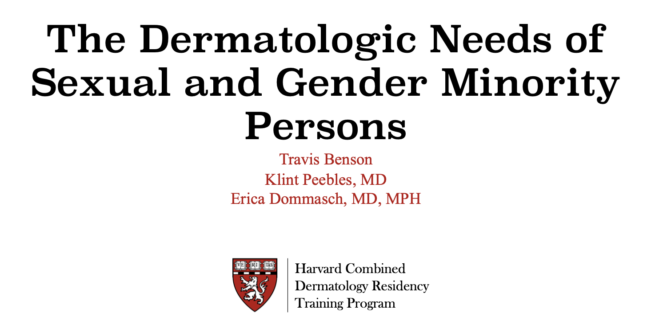
Resources
Examples of supplementary material for curricular integration
Powerpoint templates for LGBTQ/SGM health education in dermatology
Gao, et al. Dermatologic Clinics. 2023.
Notes:
2018 review showed that only one of 293 cases in the BDC discussed an LGBT patient (woman in same sex marriage with BCC).
No examination of higher level educational outcomes.
Curricular development in SGM health should target longitudinal knowledge retention and clinical skills acquisition in line with AAMC competency recommendations.
Recent systematic review since the introduction of the AAMC competencies: Only 6 of more than 3,000 studies related to SGM health education curricula assessed student’s ability to retain info regarding care for SGM people for longer than one day (just immediate pre/post knowledge) and 2 assessed clinical skills acquisition. None specifically taught about intersectional identities impacted by overlapping systems of oppression.

Slide 56
“effective policy is the tip of the spear by which evidence becomes practice. We do advocacy because advocacy helps us save lives.” - Michael j. klag, md mph dean emeritus, johns Hopkins Bloomberg school of public health

Slide 57
Thank you!
Klint Peebles, MD FAAD
Klint.peebles@gmail.com
@jkpeebles

