Slide 1
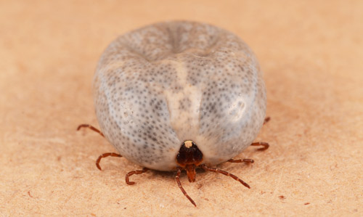
The alpha-gal syndrome:
red meat allergy and more
Jeffrey M. Wilson, MD, PhD
Assistant Professor, Allergy & Immunology
University of Virginia
Notes:
Thank you for the opportunity to be here this morning and talk a little about the tick-acquired mammalian meat allergy, or alpha-gal syndrome. As many of you may know, important parts of the alpha-gal story 1st came out of work here at UVA some 15 years ago led by Tom Platts-Mills and Scott Commins. Tom would have liked to present part of this story this morning but sends his regards as he is currently overseas.

Slide 2
Disclosures
Received assay and research support from Thermo-Fisher/Phadia
Notes:
We are grateful to Thermo-Fisher/Phadia for some research support

Slide 3
My Objectives
Give a brief overview and history of the tick-acquired mammalian meat allergy, aka – the ‘alpha-gal syndrome’ (AGS)
Highlight that the syndrome can have diverse and idiosyncratic presentations
Provide tips on diagnosis and management
Notes:
My goal this morning is to…give a brief history and overview of alpha-gal, discuss presentation and highlight some tips on diagnosis and management

Slide 4
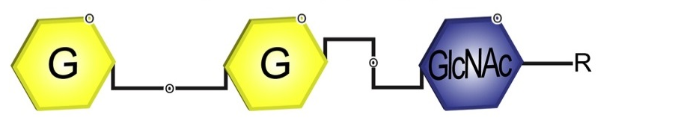
Alpha-gal: an oligosaccharide
The oligosaccharide galactose-α-1,3-galactose
α1,3
β1,4
Notes:
To start - When we talk about a-gal we are talking about the oligosaccharide gal-a-1,3gal, though some would argue the full epitope is the trisaccharide as shown here.

Slide 5
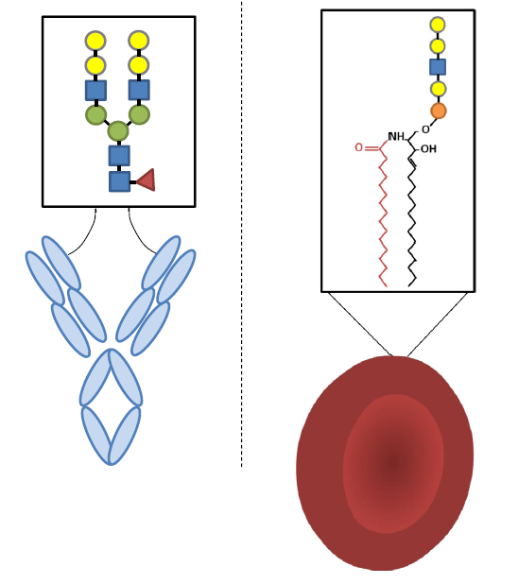
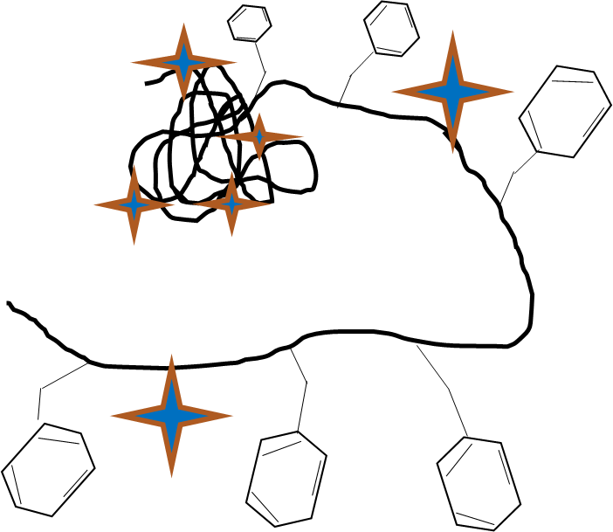
Alpha-gal: present on glycoproteins and glycolipids
Beef thyroglobulin
Rabbit red blood cell
Notes:
As an oligosaccharide it can be linked to both proteins and lipids. For example, bovine thyroglobulin is an example of a protein that is heavily decorated with alpha-gal glycans and the cell membrane of rabbit red blood cells contain a high density of alpha-gal bearing glycolipids. Accordingly, these are often used in laboratory studies of alpha-gal

Slide 6
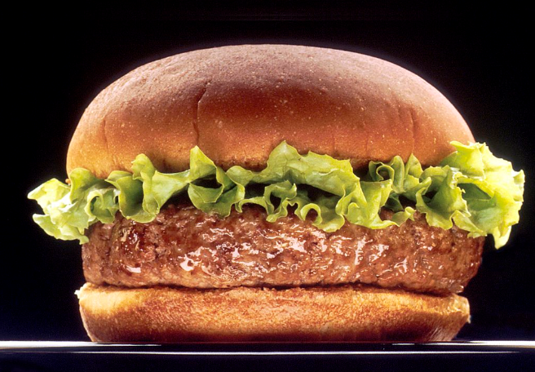
‘100 billion α-Gal epitopes in a typical burger’
-Uri Galili
Notes:
But there is reason it is often known as the “red” meat allergy, and that’s because bovine and porcine muscle, which we consume as meat, have fairly abundant alpha-gal content. And this is why if you have IgE Abs against alpha-gal and eat a cheeseburger, you are at risk for an allergic reaction.

Slide 7
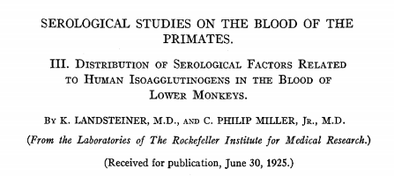
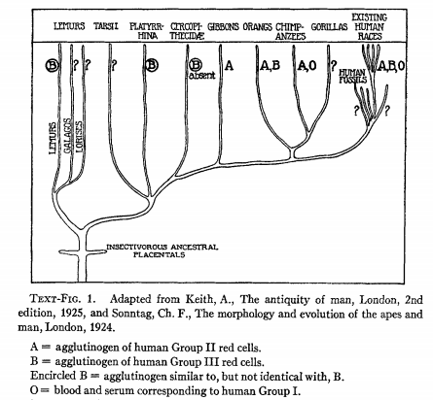
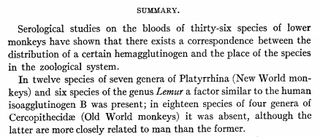
Alpha-gal: a ‘B-like’ antigen
Notes:
But before getting into the details of alpha-gal allergy story, I’d like to back up a little bit. Although alpha-gal is new in the allergy world, it has been known to biomedical science for much longer. It was actually nearly a century ago that Landsteiner and Miller reported on a “factor similar to the human …B antigen” present on RBC of non-primate mammals and new world monkeys. As part of this work it was also evident that humans had a serologic factor that bound to this antigen.

Slide 8
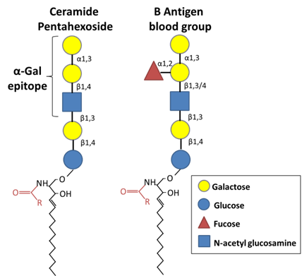
Alpha-gal : a ‘B-like’ antigen
Notes:
By all accounts they were referring in 1925 to what we now appreciate to be alpha-gal. As shown here the structure of alpha-gal differs from B the antigen only in that it lacks a fucose residue.

Slide 9
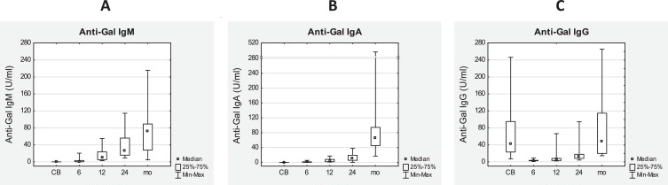
Alpha-gal : a ‘B-like’ antigen
Humans don’t express alpha-gal, but do produce abundant “natural” Ab which recognize it
Hamanova et al. Immunol Letters, 2015
Notes:
As suggested by the 1925 paper, while humans lack the enzymatic machinery to synthesize alpha-gal, IgM, IgG and IgA antibodies which target alpha-gal are universally expressed. And as a side note, these Abs represent an important barrier in xenotransplantation, and accordingly knock-out pigs that lack alpha-gal are now being tested in transplant clinical trials. But what about the central player in today’s talk - IgE??

Slide 10
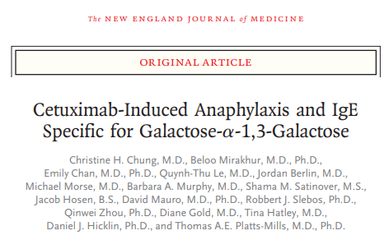
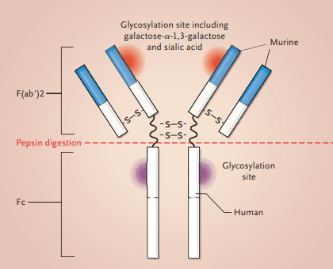
Alpha-gal: an overview in relation to allergy
2008: causal epitope in IgE-mediated immediate anaphylaxis to cetuximab
Chung et al. NEJM, 2008
Notes:
The alpha-gal IgE story really begins some 15 yrs ago as part of an investigation into cases of immediate anaphylaxis to cetuximab, a new mAb being tested for colorectal cancer, which had been reported in academic centers in the southeastern USA. Investigation into the cause of these cases led to the realization that cetuximab expressed alpha-gal and patients who reacted had IgE that recognized alpha-gal.

Slide 11
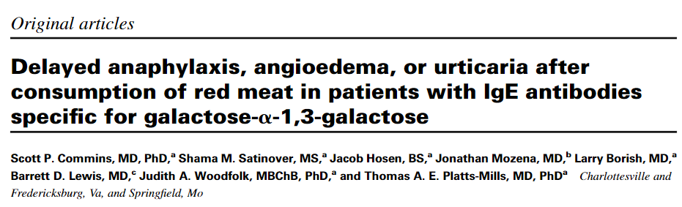
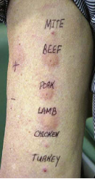
Alpha-gal: an overview in relation to allergy
2008: causal epitope in anaphylaxis to cetuximab
2009: causal in IgE-mediated syndrome of delayed anaphylaxis to red meat
Commins et al. JACI, 2009
Notes:
Shortly thereafter IgE to alpha-gal was connected to delayed allergic reactions to mammalian meat. It’s important to emphasize that this discovery relied heavily on the alpha-gal IgE assay that had been developed as part of the cetuximab work.

Slide 12
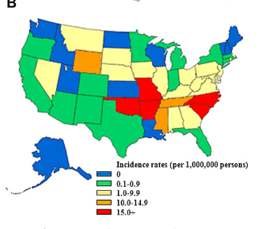
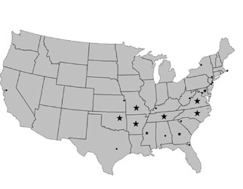
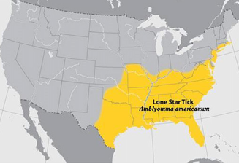
Alpha-gal: an overview in relation to allergy
2008: causal epitope in anaphylaxis to cetuximab
2009: causal epitope in syndrome of delayed anaphylaxis to red meat (ie, α-Gal syndrome)
2011: Ticks are a major cause of alpha-gal IgE sensitization
RMSF cases
α-Gal cases
Lone star tick distribution
Commins et al. JACI, 2011
Notes:
And a role for ticks in a-gal sensitization was reported soon thereafter. An early clue came from the data shown here, showing an overlap in cases with reports of RMSF and also the lone star tick.

Slide 13
Alpha-gal epidemiology
in USA and Virginia
Notes:
Now moving forward to highlight some things we have learned since those seminal papers. Where is AGS. how common is it, what is the evidence for tick bites?

Slide 14
Distribution of the syndrome in relation to the lone star tick:
A survey of allergists in practice
α-Gal Cases
No Cases
1-4
5-40
41-99
>100
CDC 2007 A. americanum tick distribution
CDC 2011 A. americanum tick distribution
Wilson & Keshavarz et al. JACI, 2021
Notes:
We now have more solid evidence about where alpha-gal cases occurring in the US. This map represents a survey of allergists we carried out to describe the distribution of alpha-gal cases across the country. Large numbers of cases are found predominantly in the southeast and almost exclusively in areas where the lone star tick is common, with a few exceptions, including a cluster of cases in northern MN.

Slide 15
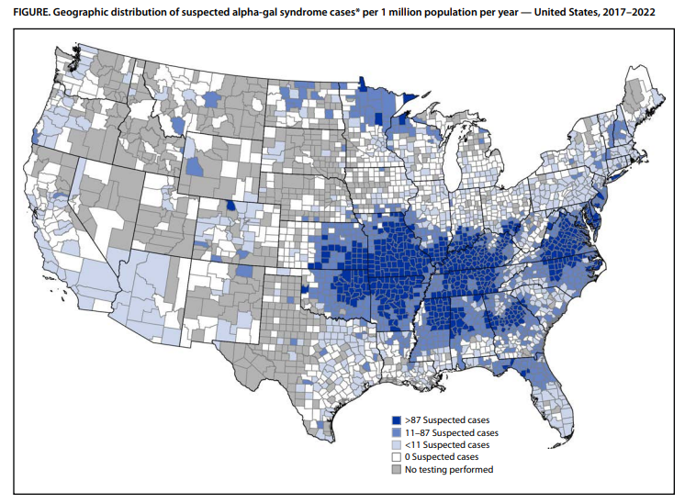
AGS case estimate based on alpha-gal IgE testing
Estimated 100,000-450,000 AGS cases since 2010
Notes:
A very recent report by the CDC described cases based on alpha-gal IgE testing carried out at what at the time was the only commercial lab in the country running the assay. Their map aligns closely with the map I just showed you and led them to roughly estimate something on the order of 100,000-450,000 AGS cases in the US since 2010.

Slide 16
Alpha-gal IgE patterns among 3000 military recruits
Ailsworth et al. JACI: In Practice, 2024
Notes:
Using a very different approach, we have also gone on to assess national alpha-gal IgE sensitization patterns without regards to clinical symptoms. Studying banked serum from 3000 incoming military personnel we again saw a very similar alpha-gal pattern. We also plotted county-level data on lone star ticks as well as the tick-borne infection ehrlichia chaffeensis, that is dominantly transmitted by lone star ticks, and saw strong overlap with our alpha-gal map.

Slide 17
Strong evidence for causal link between
tick bites and alpha-gal IgE
In USA, epidemiology and case reports highly consistent with range and history of bites from A. americanum
α-Gal IgE more likely to wane in subjects who avoid tick bites
Tick studies confirm that certain ticks, including A. americanum, make α-Gal in salivary glands during a blood feed
Tick saliva introduced into the skin of mice leads robust IgE induction, including IgE to α-Gal
Notes:
And at this point I think it is fair to say the evidence linking tick bites, particularly lone star ticks in the US, with alpha-gal is very strong. In addition to the epidemiology, we know that individuals with frequent tick bites are high risk for alpha-gal sensitization. In patients, alpha-gal IgE is more likely to wane in those who avoid recurrent tick bites. Studies in ticks confirm the presence of alpha-gal in salivary glands and saliva. And lastly, tick bites or tick saliva introduced in the skin of mice drives robust IgE induction, including to alpha-gal.

Slide 18
What is the prevalence of AGS in central VA?:
Findings from the UVA employee COVID-19 vaccine cohort
Demographics of Cohort | Total Cohort (n=267) | α-gal positive (n=43) | α-gal negative (n=224) | p-value
Age, median (IQR) | 42 (31-55) | 60 (44-68) | 40 (31-52) | <0.001
Females, n (%) | 202 (76%) | 31 (72%) | 171 (76%) | 0.55
Total IgE, GM (95% CI) | 22.5 (18.6-27.2) | 48.8 (30.7-77.5) | 18.7 (15.1-23.2) | <0.001
Mammalian Meat Allergy, n (%) | 8 (3%) | 7 (16%) | 1 (0.5%) | <0.001
Regularly eats Red Meat, n (%) | 223 (84%) | 38 (88%) | 185 (83%) | 0.35
Tick Bite in past 3 years, n (%) | 82 (30.7%) | 29 (67.4%) | 53 (23.7%) | <0.001
16% (n=43) alpha-gal IgE positive and
2.6% (n=7) with symptomatic meat allergy
Richards and Ailsworth et al. JACI: In Practice, 2024
Notes:
How about the local prevalence of symptomatic mammalian meat allergy? Clearly there will be strong regional variability, but taking advantage of a Covid vaccine antibody cohort at UVA we found a population sensitization prevalence of 16% compared to a symptomatic alpha-gal meat allergy prevalence of 2.6%. Breaking this down, it suggest that 16% of adults in our area are alpha-gal IgE sensitized, but only 16% of those experience clinical allergy. This raises the question of whether there are any features that distinguish allergic versus those are sensitized but not allergic.

Slide 19
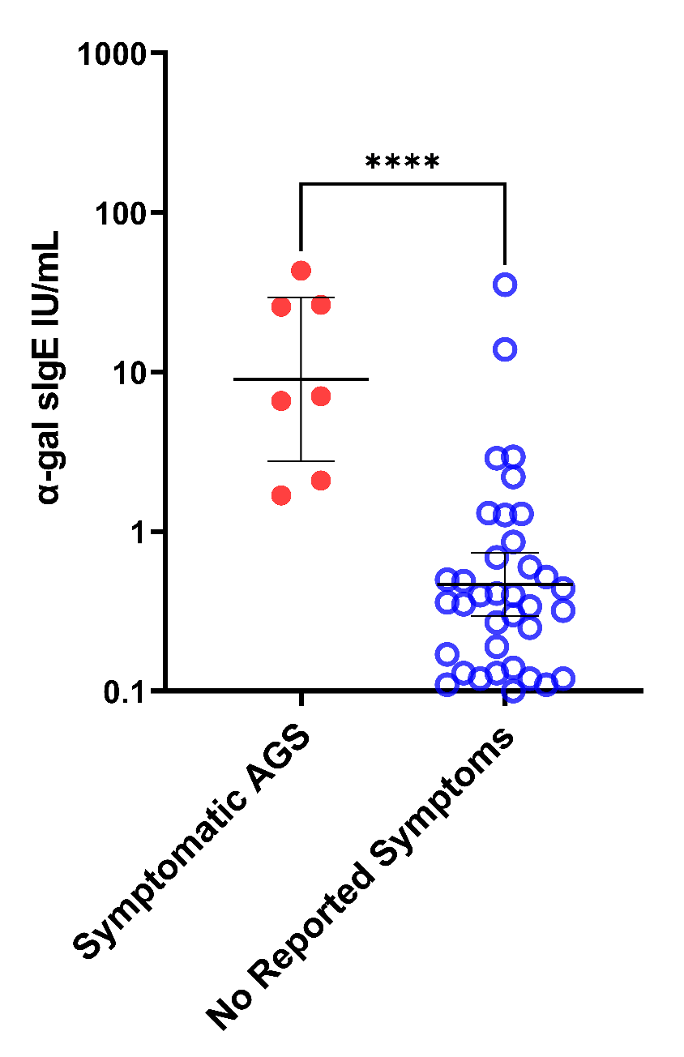
Symptomatic meat allergy more likely with
higher alpha-gal IgE levels
Notes:
It turns out that alpha-gal IgE levels can help predict, as those with symptomatic meat allergy had relatively higher alpha IgE levels, typically great than 2 kU/L

Slide 20
How does AGS Present?
Adults > Kids
Often in individuals who have tolerated red meat their entire life, but have had a tick bite in the preceding weeks/months
Classic story is ‘midnight anaphylaxis’ – hours after dinner
Hives/itch, GI distress, anaphylaxis
Notes:
How does AGS typically present?

Slide 21
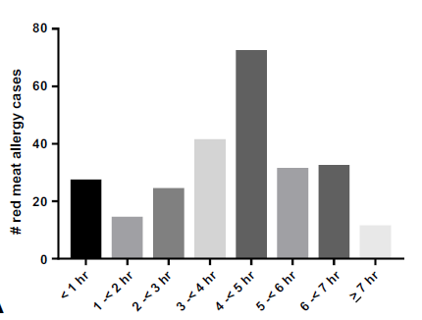
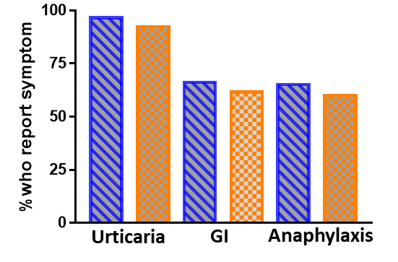
Lessons from 261 cases of self-reported
mammalian meat allergy
N=248 (95%) had testing consistent with AGS
Reported Symptom
Timing of symptom onset
*
* IgE >0.7 IU/mL to dust mite,
Timothy grass and/or ragweed
Wilson et al. JACI: In Prac, 2019
Notes:
Looking at this more systematically, this was a breakdown of self reported symptoms in 261 cases of self-reported mammalian meat allergy. Among the 245 that were consistent with alpha-gal, we found that urticaria, GI symptoms and anaphylaxis were common presentations of the AGS, regardless of whether subjects had evidence of traditional atopy.

Slide 22
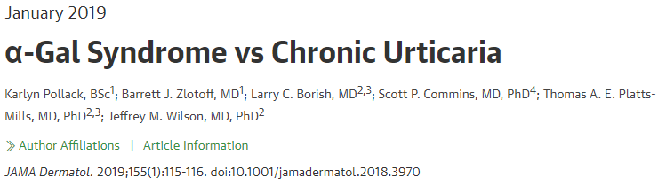
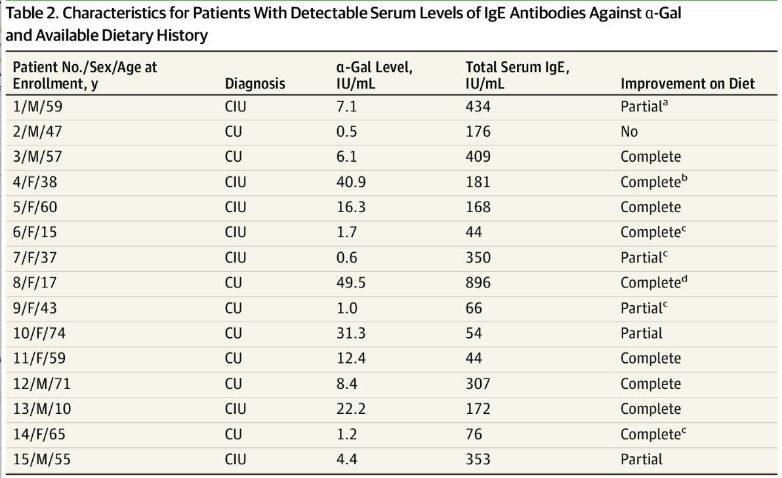
Retrospective study
of 401 AGS case-controls
29 had prior Dx of CU
20 of these were α-Gal sensitized
Diet and f/u on 15,
of which 14 partially or fully responded to diet
Notes:
A note that could be particularly relevant for this audience, is the fact the possibility that alpha-gal could be masquerading as chronic urticaria. We looked at 401 patients from a case-control AGS study and found 29 with a pre-existing Dx of CU/CIU/CSU.
Of these 20 were sensitized to alpha-gal. Of 15 with dietary and f/u information 9 reported complete response of their urticaria to a mammalian avoidance diet and 5.reported partial improvement/

Slide 23
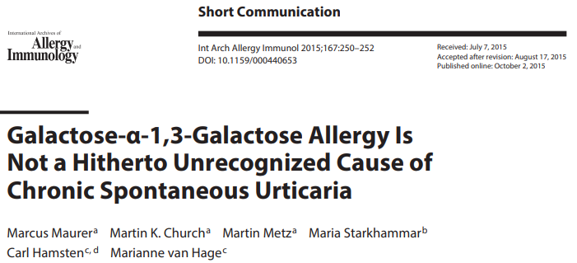
*in my clinic I often screen for
alpha-gal IgE in new CSU patients
Notes:
This is not necessarily generalizable across all populations, as reflected by this paper, but in areas where alpha-gal is prevalent or in any patient with significant tick bite history it seems reasonable to screen for alpha-gal as reversible cause of urticaria.

Slide 24
AGS diagnosis
and management

Slide 25
Diagnosis
Positive alpha-gal IgE blood test (>0.1 kU/L)
AND
Relevant clinical history (urticaria, GI distress, anaphylaxis) following mammalian meat or other mammal-derived product
AND
Response to elimination/avoidance
Notes:
Diagnosis relies on a combination of testing, clinical history and response to avoidance diet

Slide 26
Management
Intra- and inter-patient variability
IgE level has imperfect specificity for reaction likelihood AND does not predict severity
Augmentation factors can modulate risk and/or severity of reactions
NSAIDs, exercise, alcohol
Notes:
Management
Important to realize that there can be significant inter-patient and even intra-patient variability. The explanation for this is not clesr, but co-factors such as NSAIDS, exercise and particualry alcohol can module risk and also severity of reactions.

Slide 27
More than red meat…
Food
Medications/Biologics
Higher
Risk
Beef, pork, and other meat,
and also innards, of
non-primate mammals
Cetuximab
Gelatin plasma expanders
Anti-venom (e.g. – CroFab)
Lower
Risk
Dairy, including
milk and cheese
Gelatin-containing vaccines
(e.g. – Zostavax, MMR)
GelCaps
Heparin
Pancreatic enzyme replacement
(e.g. –pancrelipase & others)
Gelatin-containing foods
Cat gut sutures
Mg Stearate, Stearic Acid, Glycerin, Carrageenan
Platts-Mills et al. JACI: In Prac, 2020
Notes:
In thinking about alpha-gal, it is important to realize that some subjects can react to mammalian food products in addition to meat. The best examples are dairy and gelatin. There are also a host of other medications and biologics which contain or may contain alpha-gal and could cause reactions. Here we classified risk based on our clinical experience and based on what is known about alpha-gal content in these products.

Slide 28
Avoidance, 3 steps:
  All patients with active AGS should stay away from mammalian meat and tick bites (advocate for permethrin)
  A subset of patients (~20%) also benefit from staying away from dairy and gelatin
  A smaller subset (~1-5%?) may need to avoid a host of medications and products that are sourced with mammal-derived products
Treat reactions stemming from exposure: Cetirizine/Diphenhydramine for mild reactions; EpiPen for severe reactions
Counsel on natural history: varies by patient, but tick avoidance is factor best understood to lead to future tolerance
Don’t blame α-Gal for all the symptoms: Patients sensitized to α-Gal with new onset urticaria, dermatitis or pruritus that does not respond to full mammalian avoidance diet should receive conservative therapies targeting their condition
Notes:
Avoidance, etc

Slide 29
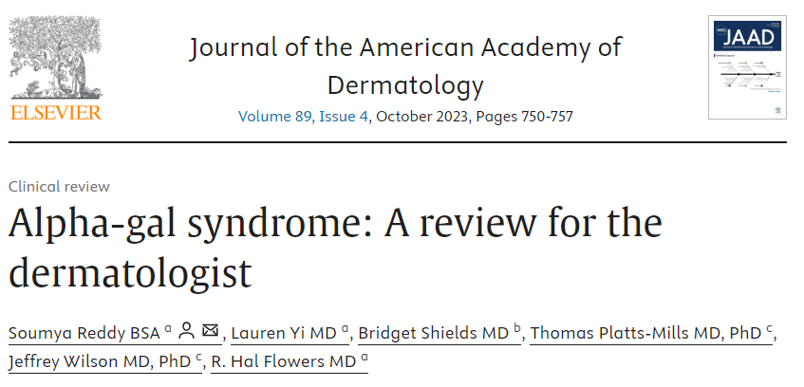

Slide 30
Thank You
UVA Cardiology
Coleen McNamara, MD
Angela Taylor, MD, MPH
*Anh Nguyen, PhD
Thomas Platts-Mills, MD, PhD
Pam Schoppee Bortz, PhD
Lisa Workman, BA
Matthew MacCallum, BA
Nathan Richards, MD
*Sam Ailsworth, BA
*Behnam Keshavarz, PhD
UVA Microbiology
Loren Erickson, PhD
UVA Dermatology
Hal Flowers, MD
USUHS
Cade Nylund, MD, MS
NIH R37 (Platts-Mills), NIH R01 (McNamara), DoD TBDRP (Nylund),
NIH R21, AAAAI Foundation, UVA Manning COVID-19 fund (Wilson)
Qs: jmw2gc@virginia.edu

Slide 31
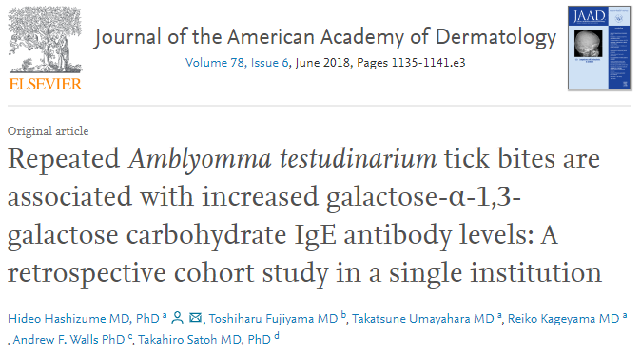
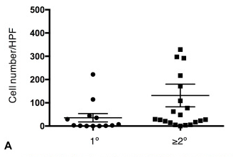
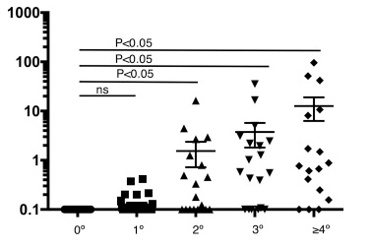
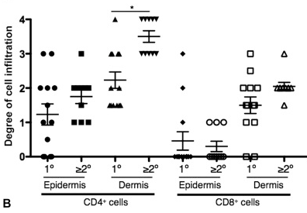
Dermal basophils in tick bite
biopsy in relation to prior tick bites
Serum α-Gal IgE in relation
to historic # of tick bites
T cells in tick bite biopsy
in relation to prior tick bites

Slide 32
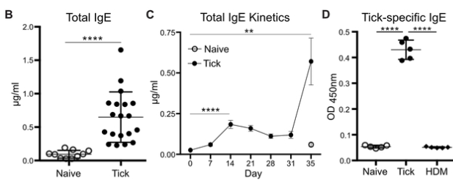
Ticks are proficient at inducing IgE, independent of α-Gal
Larval A. americanum extracts inoculated into skin of C57BL/6 mice at day 0, 7 and 31
Chandrasekhar et al. J Immunol, 2020

Slide 33
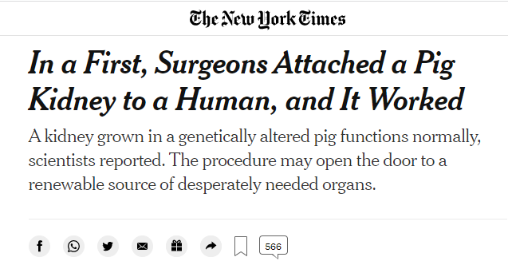
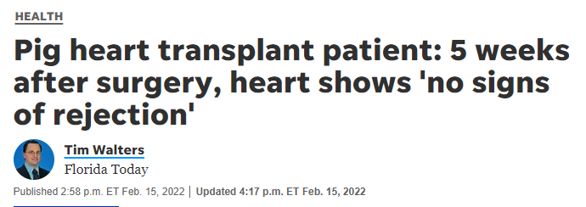
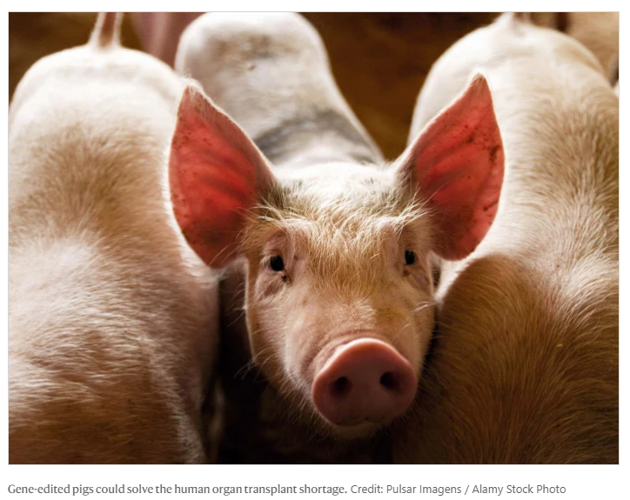
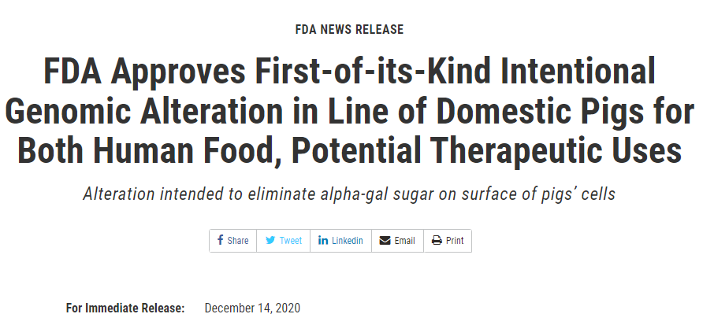
Alpha-gal: a major xeno-antigen
Anti-Gal IgM and IgG → hyperacute rejection of porcine/bovine organs

Slide 34
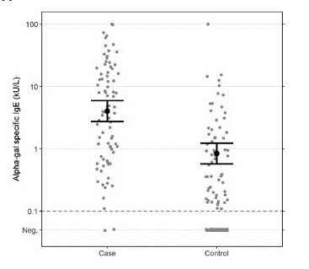
Symptomatic meat allergy more likely with
higher alpha-gal IgE levels
Kersh et al. Ann Allergy Asthm Immunol, 2022
Notes:
It turns out that alpha-gal IgE levels can help predict, as those with symptomatic meat allergy had relatively higher alpha IgE levels, typically great than 2 kU/L

Slide 35
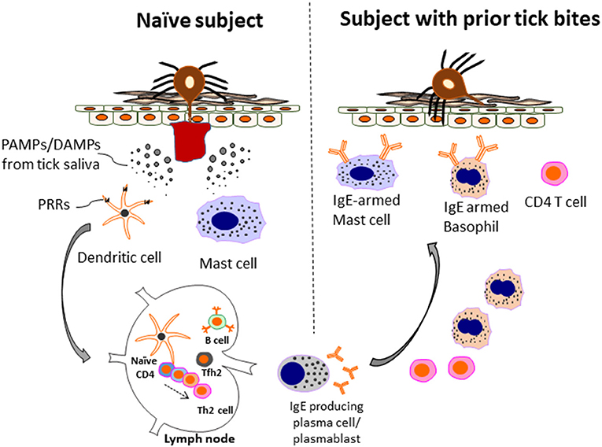
Role for basophils and tick-specific IgE
in “acquired tick resistance”
Keshavarz et al. Front Allergy, 2021

